Slide 1
A Case for Cystic Fibrosis: A Québec Perspective
Tamara Western
McGill University
CASE STUDY LECTURE SLIDES
How to use these slides:
These slides are intended to complement the material presented in Modules 1-6 of the case study.
You can include as many or as few of these slides into your lectures depending on the level of detail into which you wish to explore CF with your students.
Feel free to modify the slides so that they fit with your lecture or course content.
SALTISE.ca
Complete Materials

Slide 2
A Case for Cystic Fibrosis: A Québec Perspective
Tamara Western
McGill University
CASE STUDY LECTURE SLIDES
Modules 1-2
SALTISE.ca
Complete Materials

Slide 3
Case Study Assignments (5%)
A Case for Cystic Fibrosis: A Québec Perspective
Tamara Western
McGill University
New this year!
A case study has been developed to span the course – this year it is on Cystic Fibrosis
There will be 6 modules – each will include a short assignment (each worth 1% of your final grade (best 5/6)
It will conclude with a guest lecture on current research in cystic fibrosis at the end of the course
SALTISE.ca
Complete Materials

Slide 4
A Case for Cystic Fibrosis - A Québec Perspective
A Case for Cystic Fibrosis: A Québec Perspective
Tamara Western
McGill University
Part I: CF as a Mendelian Disorder
Part II: Quebec CF Population Genetics
Part III: From Genotype to Phenotype
Part IV: CF Genetic Screening
Part V: CF Bacterial Genetics
Part VI: Gene Therapy
SALTISE.ca
Complete Materials
Notes:
Here, I think it would be good to introduce the case study and how this will run. So maybe just introduce CF a little bit, I can write more details if youd like.

Slide 5
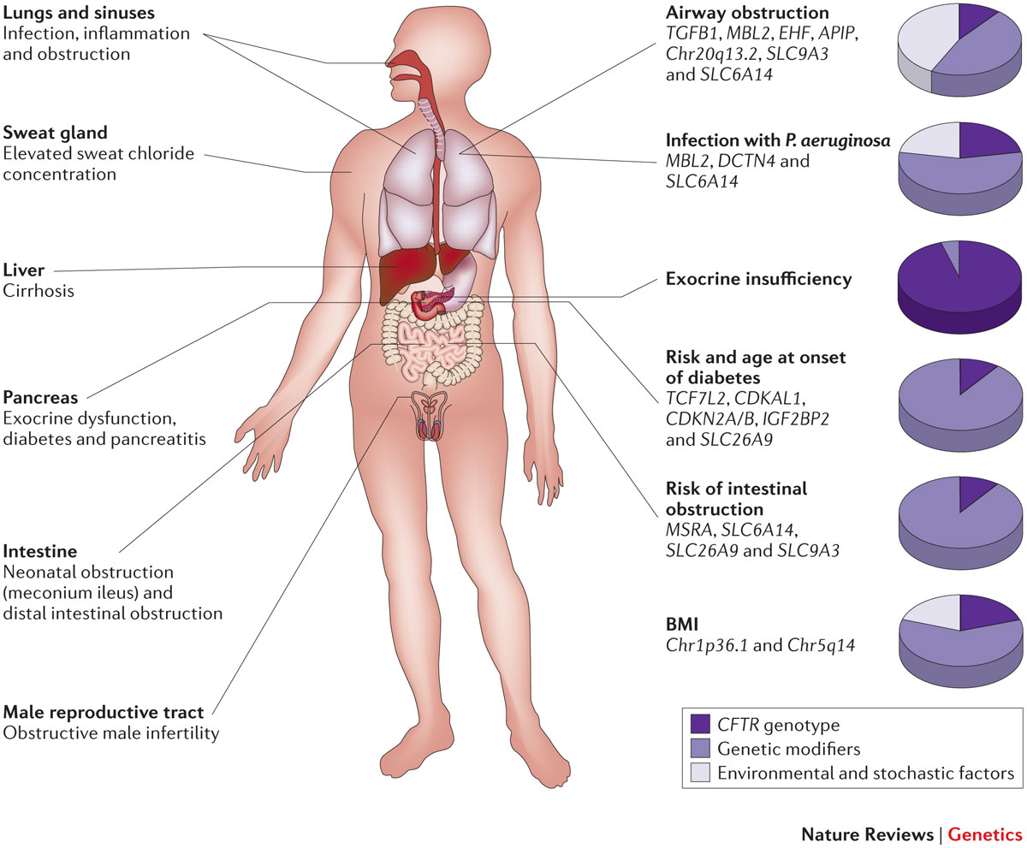
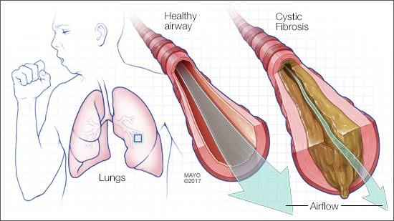
A Case for Cystic Fibrosis: A Québec Perspective
Tamara Western
McGill University
A Case for Cystic Fibrosis - A Quebec Perspective
Mayo Clinic
Nat Rev Genet. 2015 Jan; 16(1): 45–56.
SALTISE.ca
Complete Materials

Slide 6
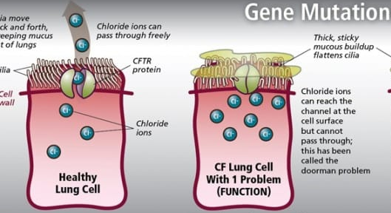
Part I: CF as a Mendelian Disorder
A Case for Cystic Fibrosis: A Québec Perspective
Tamara Western
McGill University
Cystic Fibrosis is a prevalent autosomal recessive disorder in Canada & Quebec
Mutation in the Cystic Fibrosis Transmembrane Receptor (CFTR gene)
  Cloned by researchers at Hospital for Sick Children - Toronto
The origins are disputed, but thought to be IndoEuropean
http://cysticfibrosis.com/know-your-cf-mutations/
https://www.cysticfibrosis.ca/about-cf/what-is-cystic-fibrosis
SALTISE.ca
Complete Materials

Slide 7
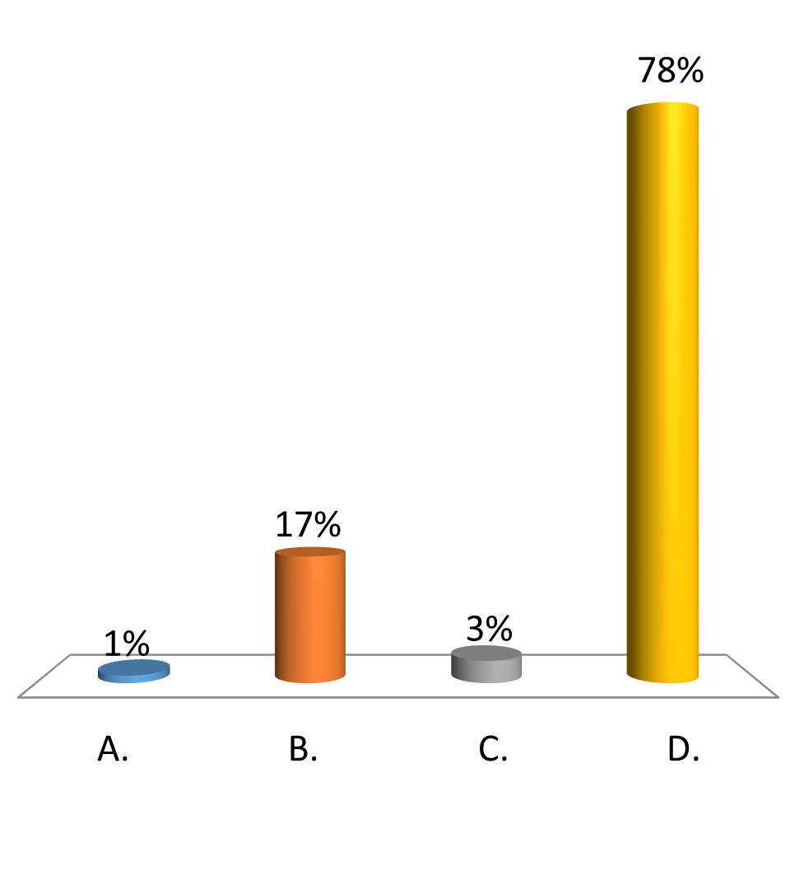
Cystic Fibrosis (CF) is a recessive condition caused by a single mutation. Normal parents have a child with CF. What is the probability that their next child will be normal?
A Case for Cystic Fibrosis: A Québec Perspective
Tamara Western
McGill University
0
1/4
1/2
3/4
SALTISE.ca
Complete Materials

Slide 8
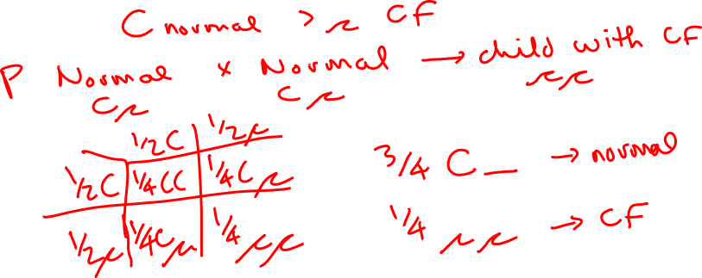
A Case for Cystic Fibrosis: A Québec Perspective
Tamara Western
McGill University
Cystic Fibrosis (CF) is a recessive condition caused by a single mutation. Normal parents have a child with CF. What is the probability that their next child will be normal?
SALTISE.ca
Complete Materials

Slide 9
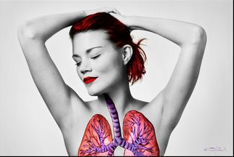
An important application for mapping:
Finding the genes underlying genetic diseases
A Case for Cystic Fibrosis: A Québec Perspective
Tamara Western
McGill University
Eva Markvoort; http://65redroses.com/
SALTISE.ca
Complete Materials

Slide 10
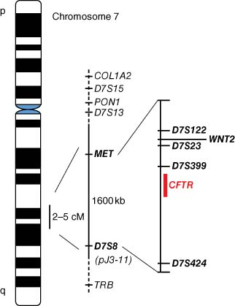
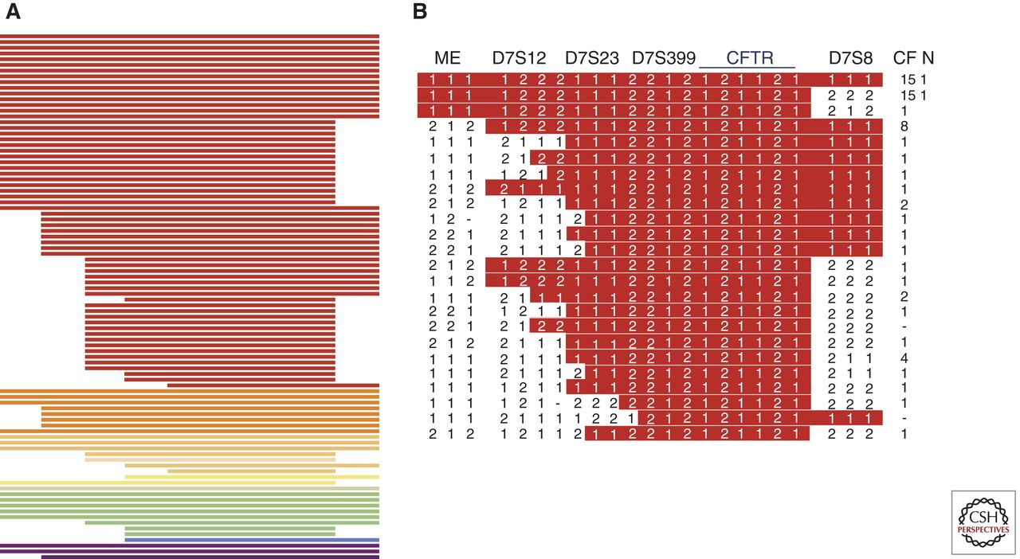
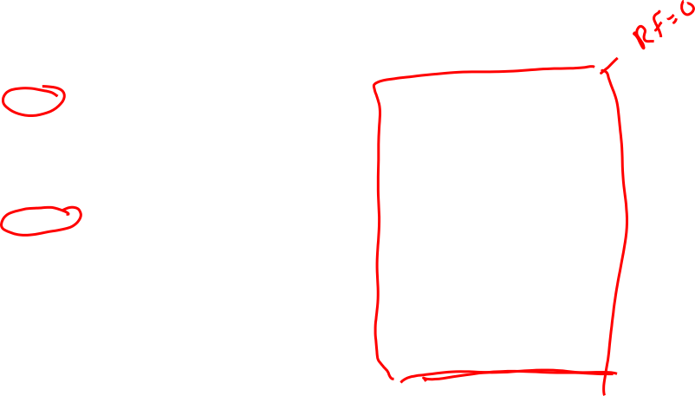
An important application for mapping:
Finding the genes underlying genetic diseases
A Case for Cystic Fibrosis: A Québec Perspective
Tamara Western
McGill University
2018 - Encylopedia of Life Sciences – Wiley
https://onlinelibrary.wiley.com/doi/full/10.1002/9780470015902.a0005376.pub2
SALTISE.ca
Complete Materials
Tsui et al. CSHL Perspect Med 2013;3:a009472

Slide 11
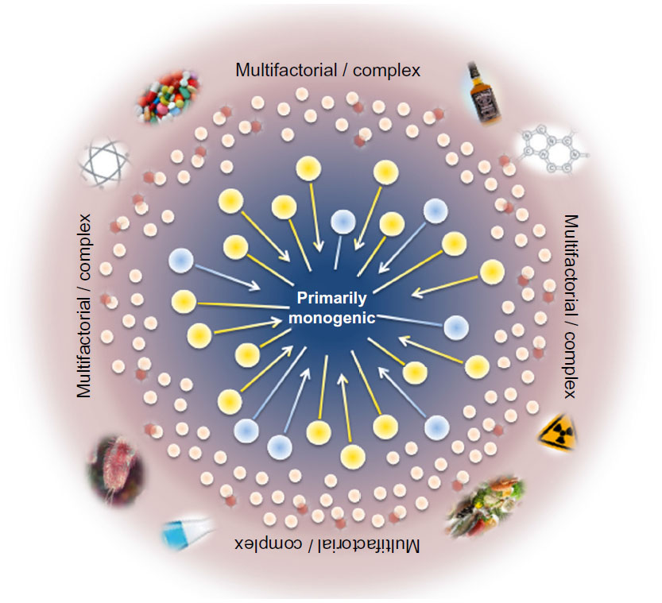
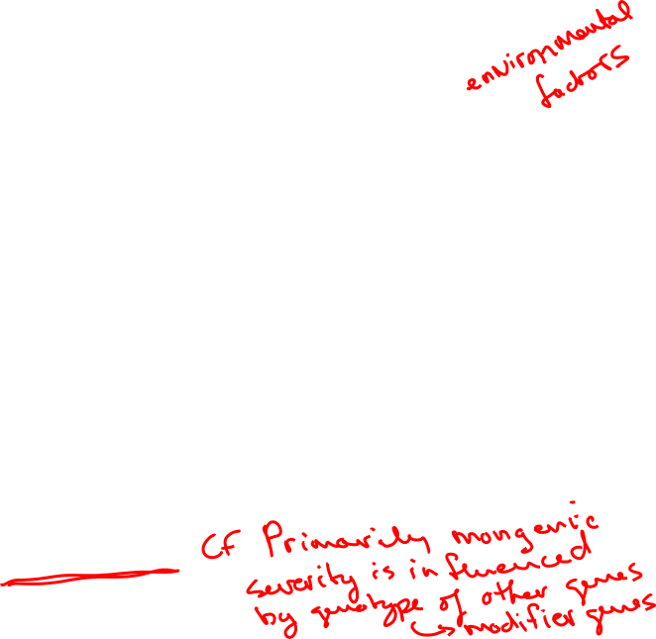
Cystic fibrosis & genetic modifiers
A Case for Cystic Fibrosis: A Québec Perspective
Tamara Western
McGill University
Gallati, Appl Clin Genet. 2014; 7: 133–146.
Cutting Nature Rev Genetics 16, pages45–56 (2015)
SALTISE.ca
Complete Materials

Slide 12
Cystic fibrosis & genetic modifiers
A Case for Cystic Fibrosis: A Québec Perspective
Tamara Western
McGill University
Cutting Nature Rev Genetics 16, pages45–56 (2015)
SALTISE.ca
Complete Materials

Slide 13
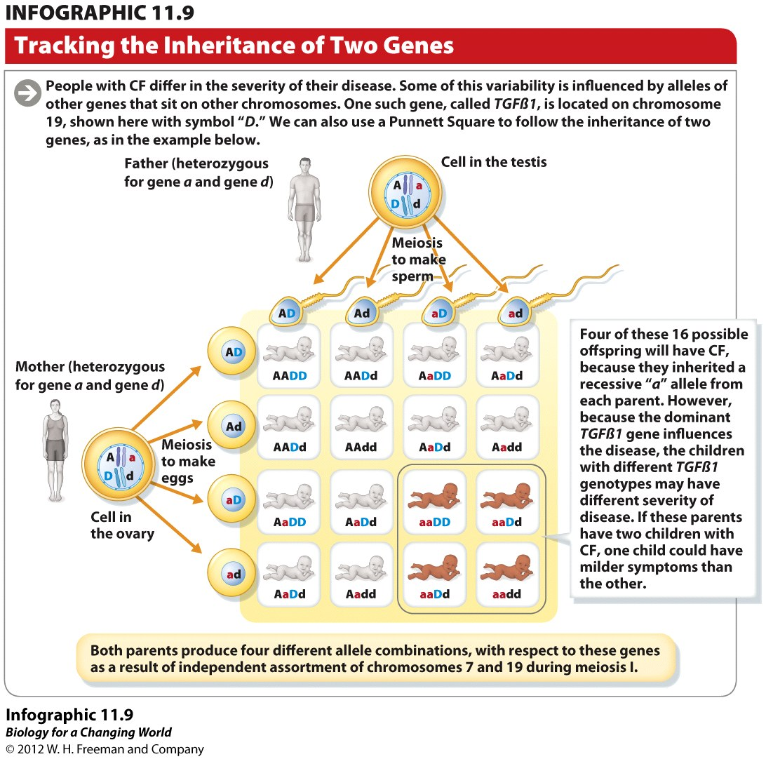
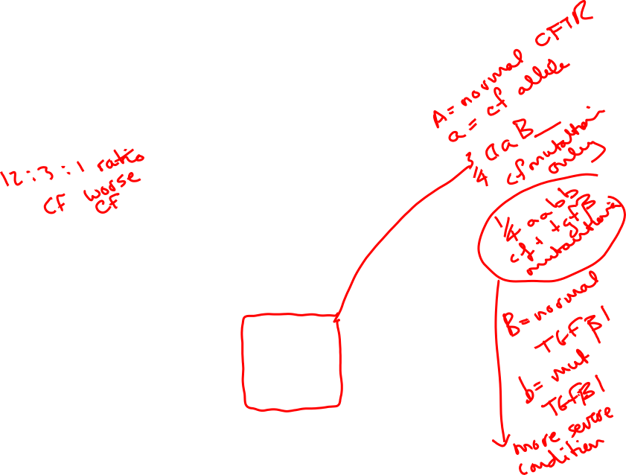
Cystic fibrosis & genetic modifiers
A Case for Cystic Fibrosis: A Québec Perspective
Tamara Western
McGill University
SALTISE.ca
Complete Materials

Slide 14
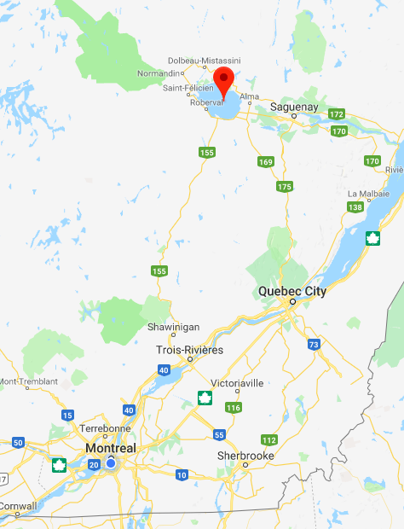
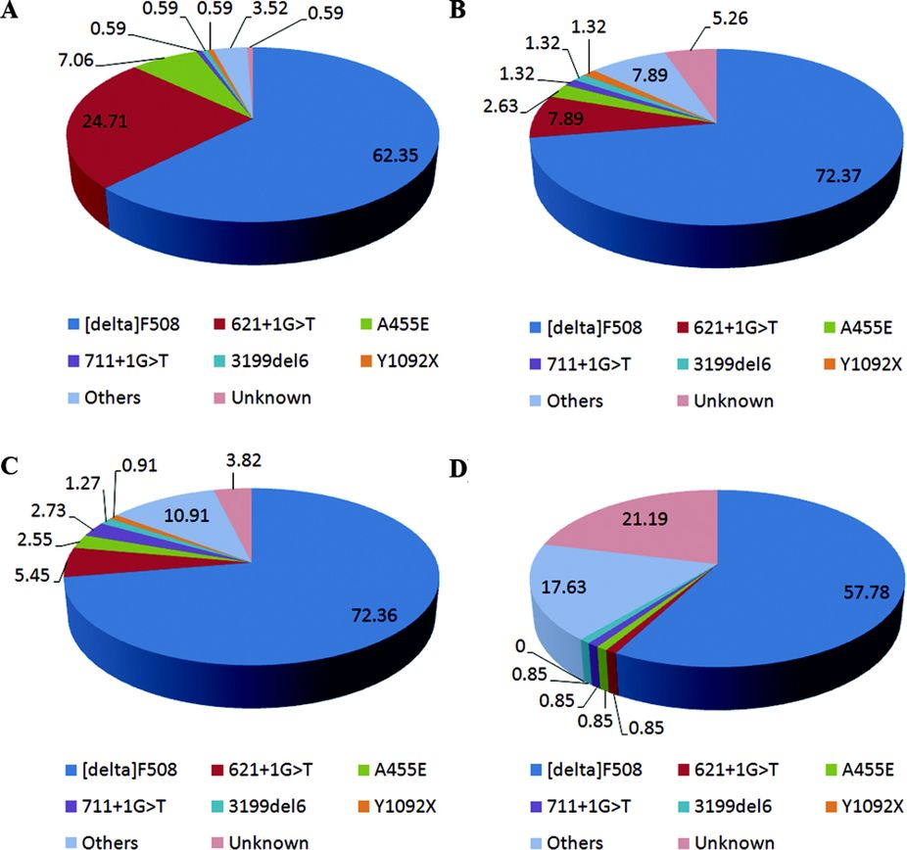
Population Genetics & Cystic Fibrosis in Quebec
A Case for Cystic Fibrosis: A Québec Perspective
Tamara Western
McGill University
Saguenay-Lac-St-Jean
Sherbrooke
Montreal - Francophone
Montreal – Anglophone/ Multiethnic
Frequency of CF in Canada ~1/3600
Frequency of CF in Quebec ~1/2500
Frequency of CF in SLSJ ~1/900
SALTISE.ca
Complete Materials

Slide 15
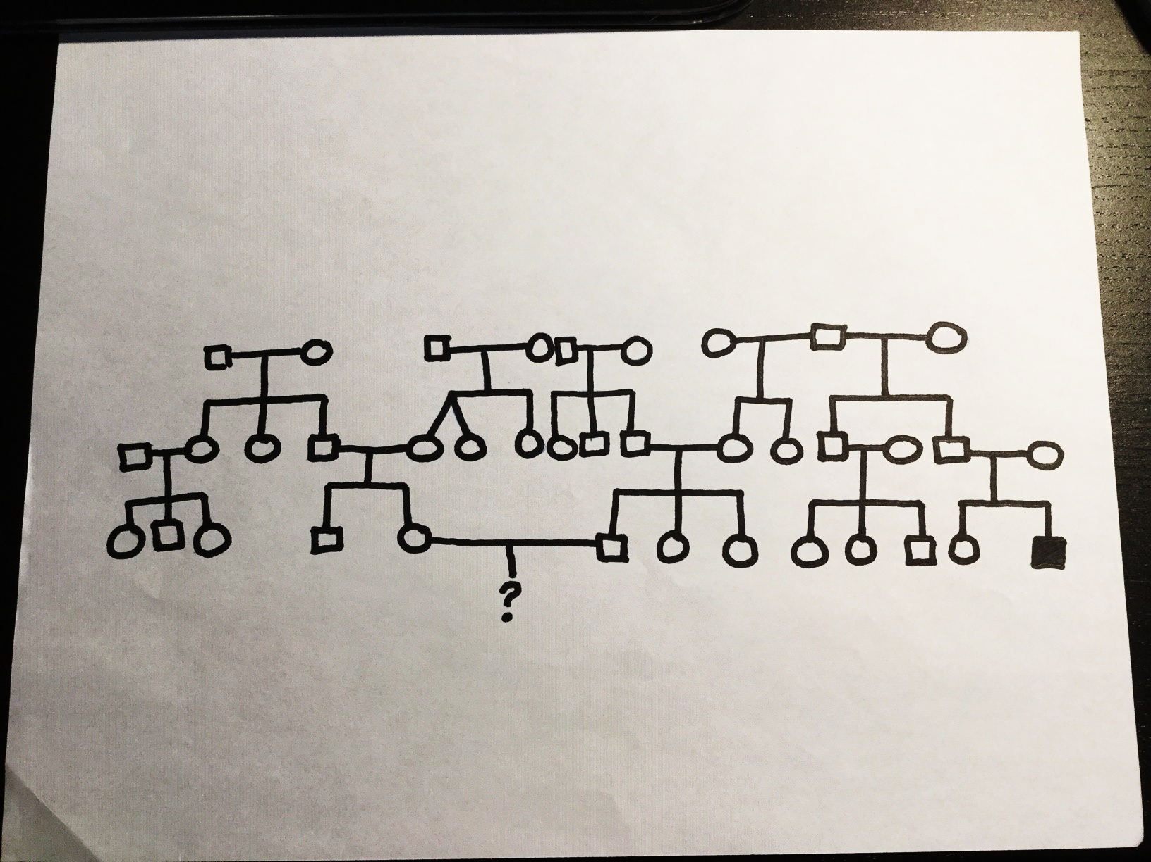
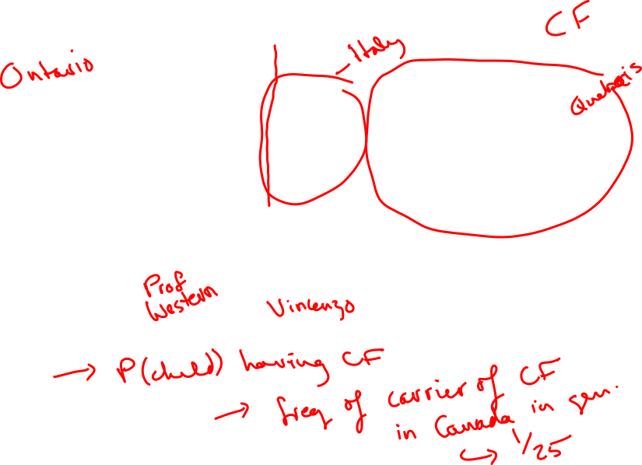
Population genetics & genetic counselling
A Case for Cystic Fibrosis: A Québec Perspective
Tamara Western
McGill University
A real Quebec pedigree…
SALTISE.ca
Complete Materials

Slide 16
Population genetics & genetic counselling
A Case for Cystic Fibrosis: A Québec Perspective
Tamara Western
McGill University
A real Quebec pedigree…
SALTISE.ca
Complete Materials

Slide 17
A Case for CF: From Genotype to Phenotype
A Case for Cystic Fibrosis: A Québec Perspective
Tamara Western
McGill University
Cystic Fibrosis caused by a mutation in the
cystic fibrosis transmembrane receptor (CFTR)
CFTR transports chloride ions across membranes to control
transport of liquids and salts
All mutations cause dysregulation in this chloride transport
Phenotypes may vary based on the mutation, with varying
severity
Genome Research Limited.
SALTISE.ca
Complete Materials

Slide 18
A Case for CF: From Genotype to Phenotype
A Case for Cystic Fibrosis: A Québec Perspective
Tamara Western
McGill University
Bell et al., 2015. Pharmacology and Therapeutics.
SALTISE.ca
Complete Materials

Slide 19
A Case for Cystic Fibrosis: A Québec Perspective
Tamara Western
McGill University
A Case for CF: From Genotype to Phenotype
Modifier Gene: the expression of one gene alters the expression of another gene often involved in disease pathology
  Ranges from primary action of target gene to intermediate phenotypes at the cellular organ or system level
  CFTR mutant mice have differing phenotypes based on the genetic background of the mouse
  Found a modifier gene in some strains with linkage studies
SALTISE.ca
Complete Materials
Notes:
Cftr mutant mice from different strains have differing disease severtiy
Linkage studies revealed a single locus with semidominant effects that account for the differences in viability
They’ve also done knockouts of the modifier gene, where they had varying viability based on the level of modifier gene expression

Slide 20
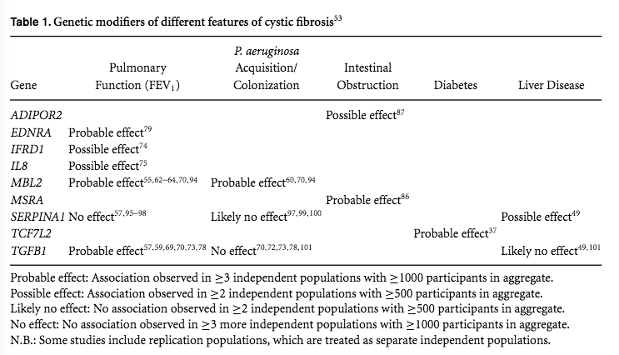
A Case for Cystic Fibrosis: A Québec Perspective
Tamara Western
McGill University
A Case for CF: From Genotype to Phenotype
Cutting, 2010. Ann. N.Y. Acad. Sci.
SALTISE.ca
Complete Materials

Slide 21
A Case for Cystic Fibrosis: A Québec Perspective
Heather Fice, Laura Nilson
McGill University
CASE STUDY LECTURE SLIDES
Modules 3-4
SALTISE.ca
Complete Materials

Slide 22
A Case for CF: From Genotype to Phenotype
A Case for Cystic Fibrosis: A Québec Perspective
Heather Fice, Laura Nilson
McGill University
Cystic Fibrosis caused by a mutation in the
cystic fibrosis transmembrane receptor (CFTR)
CFTR transports chloride ions across membranes to control
transport of liquids and salts
All mutations cause dysregulation in this chloride transport
Phenotypes may vary based on the mutation, with varying
severity
Genome Research Limited.
SALTISE.ca
Complete Materials

Slide 23
A Case for CF: From Genotype to Phenotype
A Case for Cystic Fibrosis: A Québec Perspective
Heather Fice, Laura Nilson
McGill University
Bell et al., 2015. Pharmacology and Therapeutics.
SALTISE.ca
Complete Materials

Slide 24
A Case for Cystic Fibrosis: A Québec Perspective
Heather Fice, Laura Nilson
McGill University
A Case for CF: From Genotype to Phenotype
Modifier Gene: the expression of one gene alters the expression of another gene often involved in disease pathology
  Ranges from primary action of target gene to intermediate phenotypes at the cellular organ or system level
  CFTR mutant mice have differing phenotypes based on the genetic background of the mouse
  Found a modifier gene in some strains with linkage studies
SALTISE.ca
Complete Materials
Notes:
Cftr mutant mice from different strains have differing disease severtiy
Linkage studies revealed a single locus with semidominant effects that account for the differences in viability
They’ve also done knockouts of the modifier gene, where they had varying viability based on the level of modifier gene expression

Slide 25
A Case for Cystic Fibrosis: A Québec Perspective
Heather Fice, Laura Nilson
McGill University
A Case for CF: From Genotype to Phenotype
Cutting, 2010. Ann. N.Y. Acad. Sci.
SALTISE.ca
Complete Materials

Slide 26
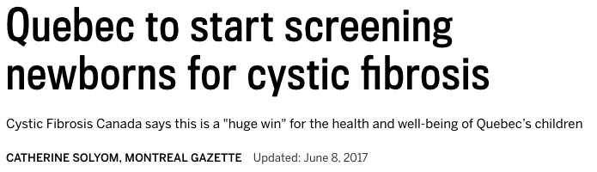
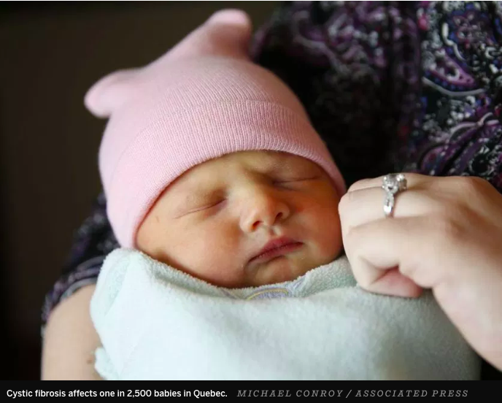
A Case for CF: Genetic Screening
A Case for Cystic Fibrosis: A Québec Perspective
Heather Fice, Laura Nilson
McGill University
Screening for CF will:
Prevent potentially irreversible consequences on growth
Potentially decrease risk of contracting lung infections
Decrease ER visits by families going through diagnosis
SALTISE.ca
Complete Materials

Slide 27
A Case for Cystic Fibrosis: A Québec Perspective
Heather Fice, Laura Nilson
McGill University
A Case for CF: Genetic Screening
Panel Sequencing
  Targeted gene sequencing for specific mutations related to a disorder
  Predesigned panels are available for CF, containing the most common mutations
SALTISE.ca
Complete Materials

Slide 28
A Case for Cystic Fibrosis: A Québec Perspective
Heather Fice, Laura Nilson
McGill University
Mamanova et al. 2010. Nat Methods.
SALTISE.ca
Complete Materials

Slide 29
A Case for Cystic Fibrosis: A Québec Perspective
Heather Fice, Nam-Sung Moon
McGill University
CASE STUDY LECTURE SLIDES
Modules 5-6
SALTISE.ca
Complete Materials

Slide 30
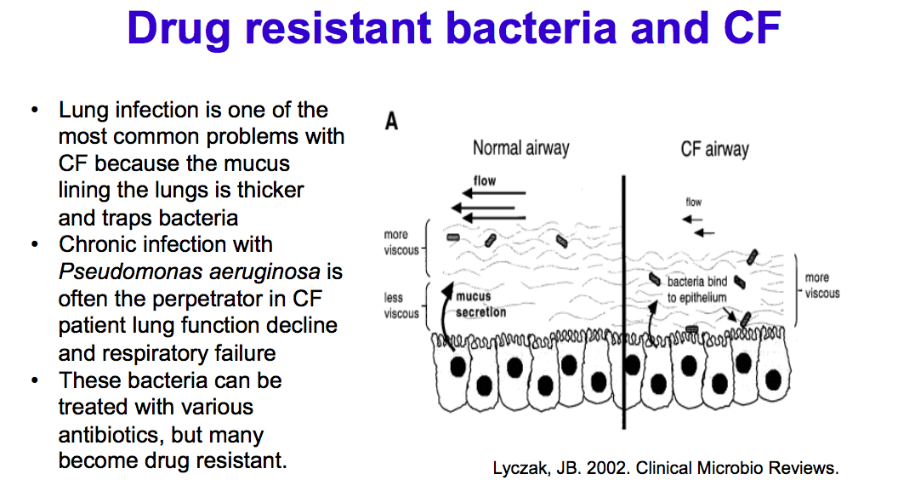
A Case for Cystic Fibrosis: A Québec Perspective
Heather Fice, Nam-Sung Moon
McGill University
SALTISE.ca
Complete Materials

Slide 31
