Slide 1
Human Genetics
Studying human genetics presents certain challenges:
Test crosses aren’t practical/ethical
We do not produce enough offspring to have informative ratios
The approach most commonly used:
Observe many generations with the help of…

Slide 2
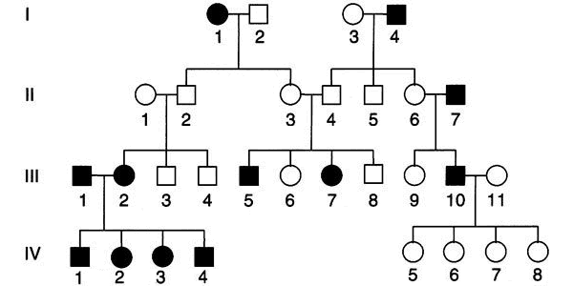
Pedigree Chart
©2002 by Griffiths et al.; all text material

Slide 3
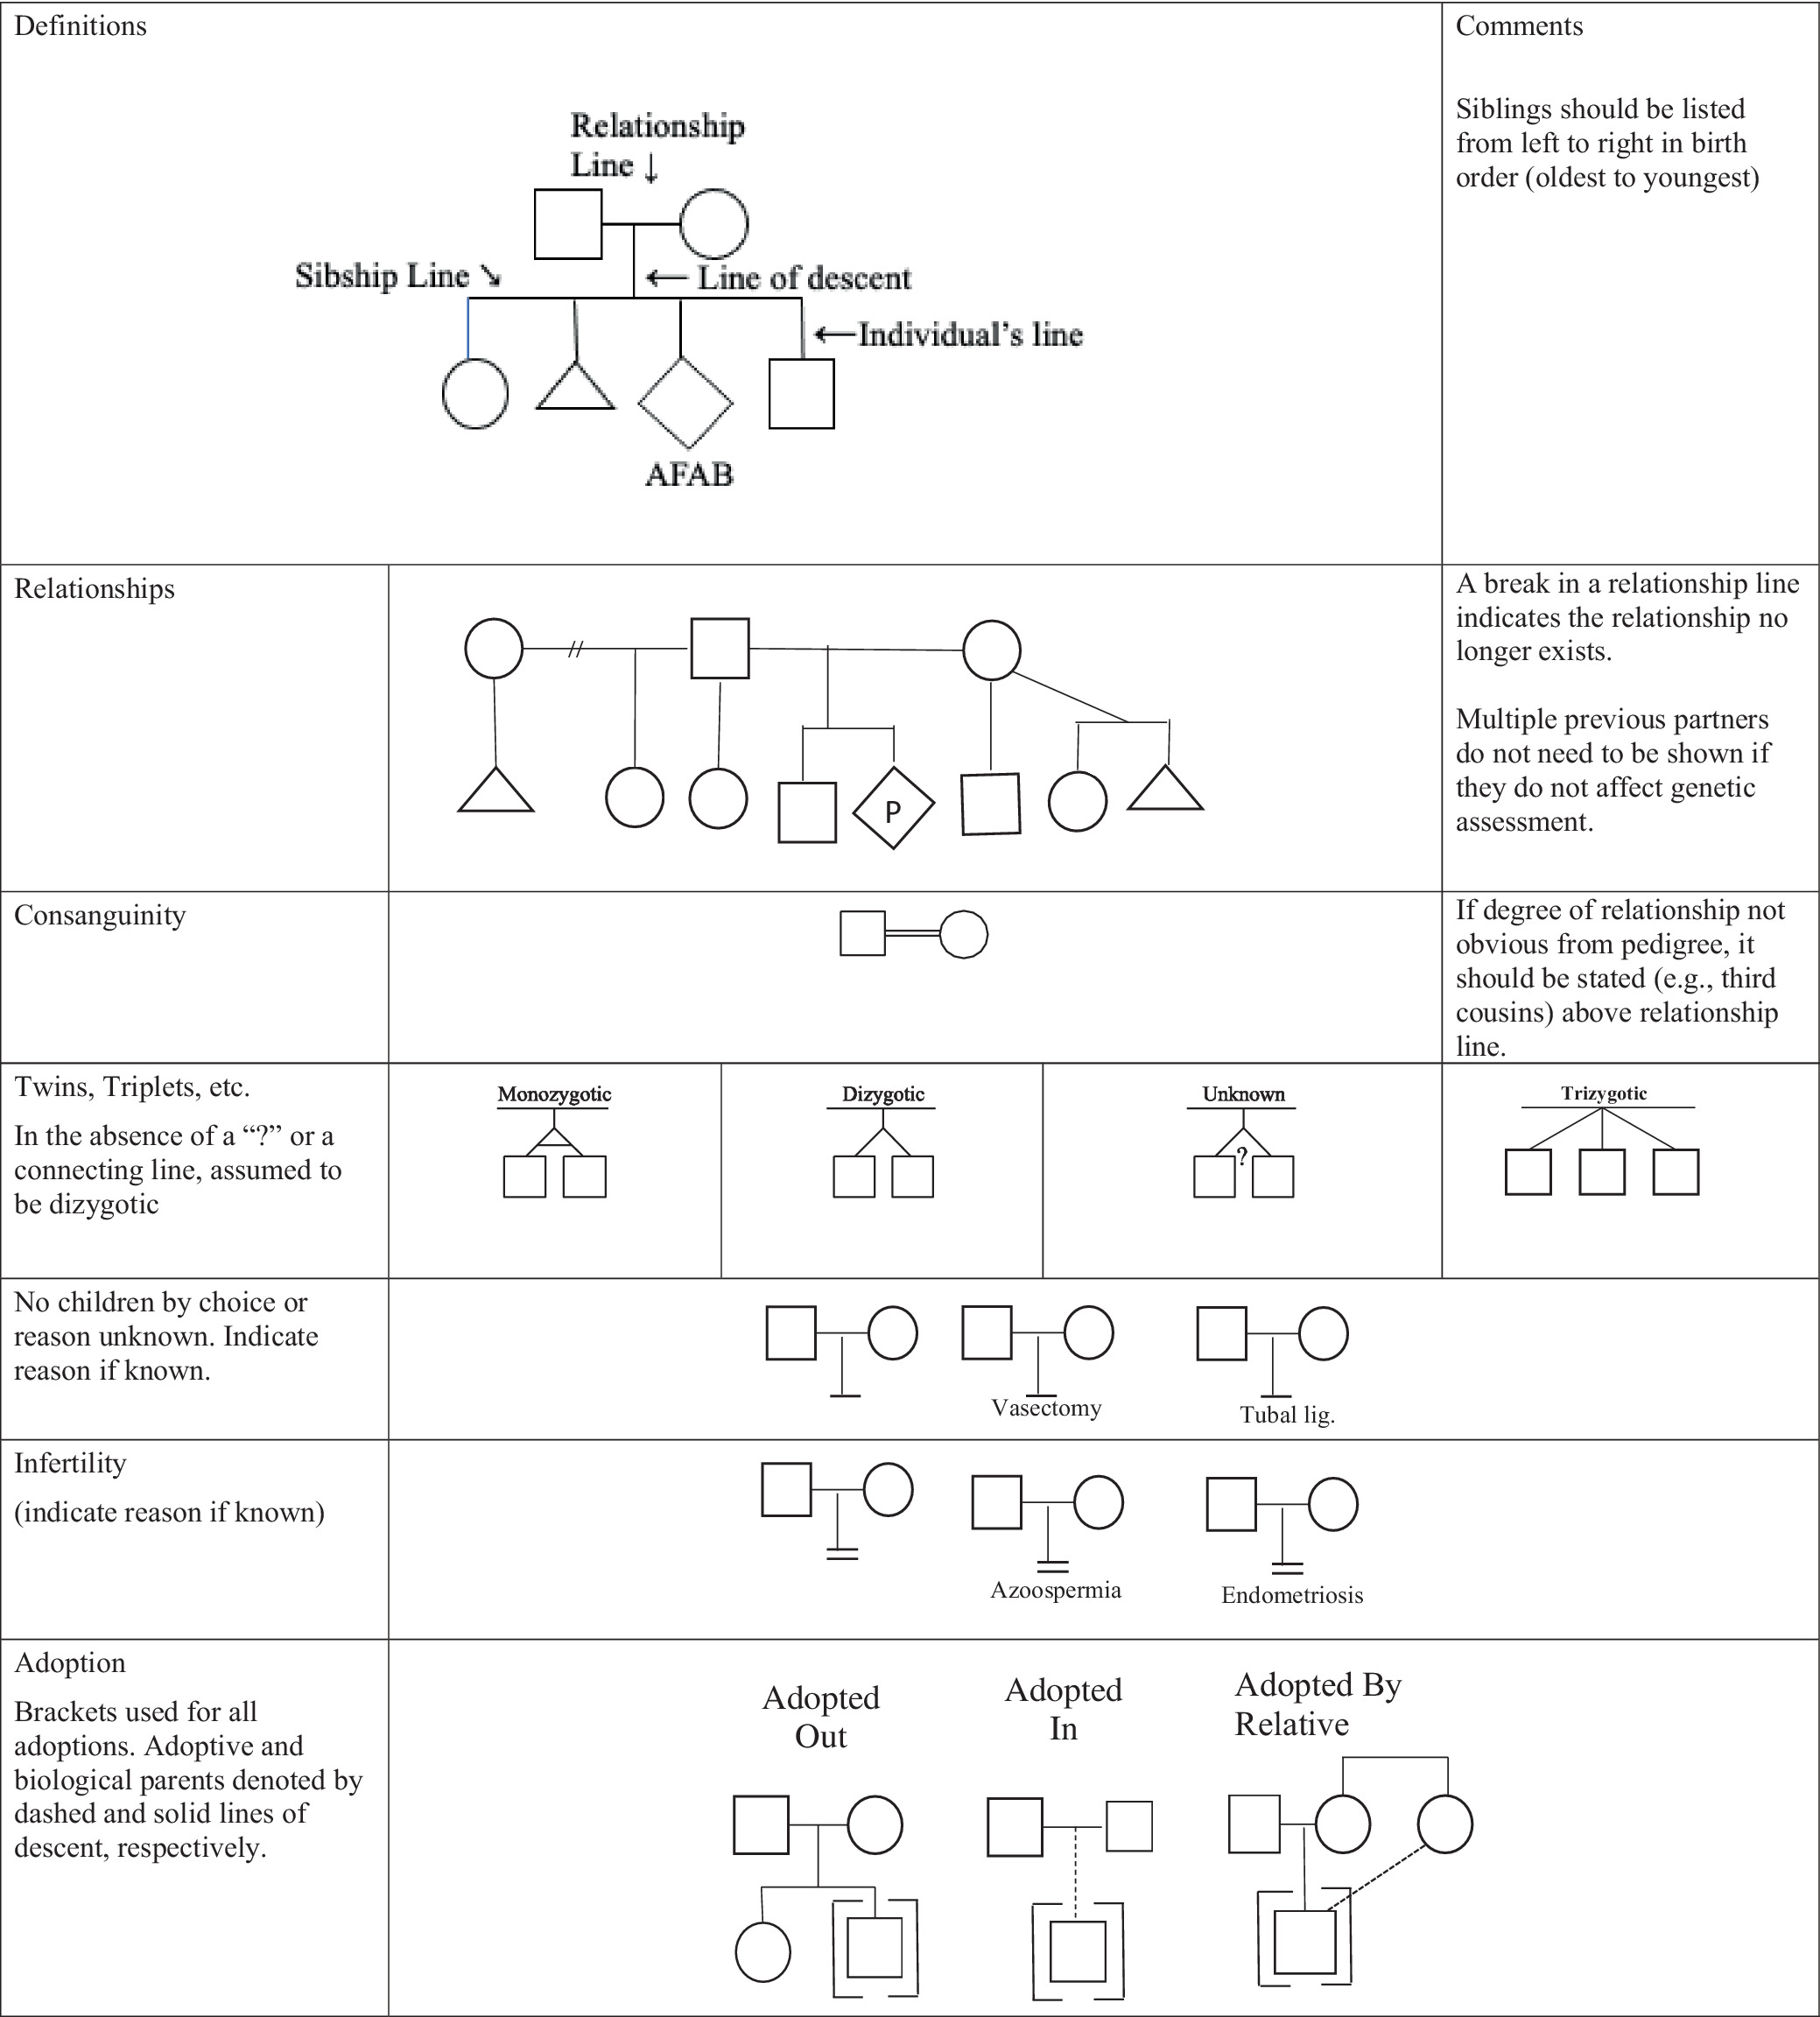
Practice resource‐focused revision: Standardized pedigree nomenclature update centered on sex and gender inclusivity: A practice resource of the National Society of Genetic Counselors
Journal of Genetic Counseling, First published: 15 September 2022, DOI: (10.1002/jgc4.1621)

Slide 4
Revised guidelines (Sep 2022)
Pedigree symbols depict GENDER
Square for male, circle for female, diamond if non-binary/gender diverse
“Affected” individuals are shaded in, unaffected are left unfilled
Note that “affected” isn’t necessarily a disease – it’s the phenotype being studied, and a Pedigree chart is used to hypothesize how that phenotype is inherited
Notes:
AMAB = assigned male at birth (afab f = female); uaab = unassigned at birth
https://onlinelibrary.wiley.com/doi/10.1002/jgc4.1621
Practice resource-focused revision: Standardized pedigree nomenclature update centered on sex and gender inclusivity: A practice resource of the National Society of Genetic Counselors
Robin L. Bennett,Kathryn Steinhaus French,Robert G. Resta,Jehannine Austin
Journal of Genetic Counselling

Slide 5
Revised guidelines (Sep 2022)
Pedigree symbols don’t depict SEX
If cisgender, no further clarification needed (gender and sex are presumed to correspond)
If transgender, specify underneath the symbol the sex that individual was assigned at birth (assigned male at birth = AMAB, AFAB, UAAB)
Notes:
AMAB = assigned male at birth (afab f = female); uaab = unassigned at birth
https://onlinelibrary.wiley.com/doi/10.1002/jgc4.1621
Practice resource-focused revision: Standardized pedigree nomenclature update centered on sex and gender inclusivity: A practice resource of the National Society of Genetic Counselors
Robin L. Bennett,Kathryn Steinhaus French,Robert G. Resta,Jehannine Austin
Journal of Genetic Counselling

Slide 6
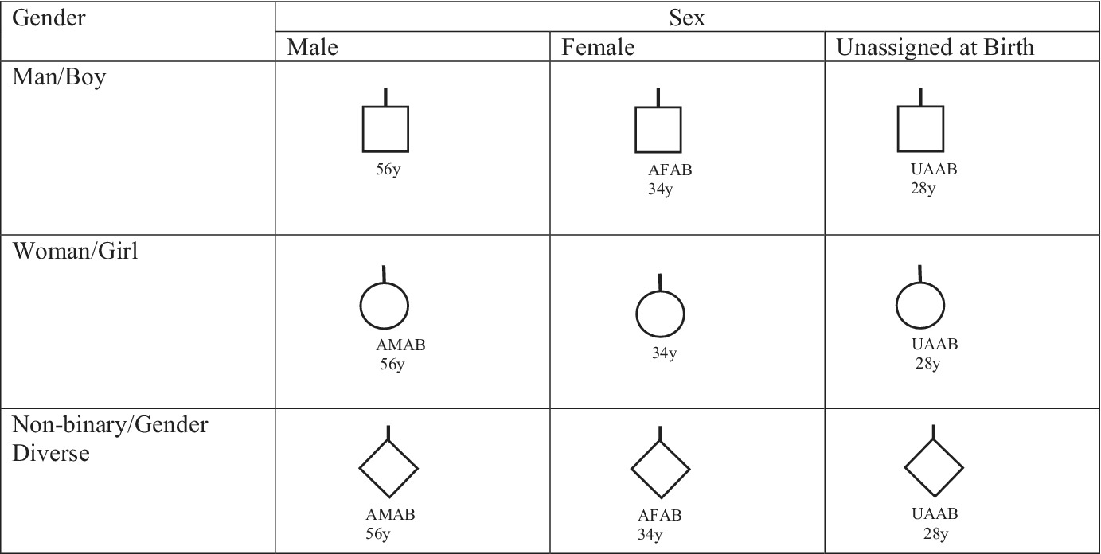
Practice resource‐focused revision: Standardized pedigree nomenclature update centered on sex and gender inclusivity: A practice resource of the National Society of Genetic Counselors
Journal of Genetic Counseling, First published: 15 September 2022, DOI: (10.1002/jgc4.1621)

Slide 7
Revised guidelines (Sep 2022)
Other elements of these inclusive pedigree chart guidelines include depicting adoption and assistive reproductive technologies:
Adoption of an individual uses a dashed line
Donor of sperm or egg for ART includes a “D” within the shape
Consult paper and following tables for more details
Notes:
https://onlinelibrary.wiley.com/doi/10.1002/jgc4.1621
Practice resource-focused revision: Standardized pedigree nomenclature update centered on sex and gender inclusivity: A practice resource of the National Society of Genetic Counselors
Robin L. Bennett,Kathryn Steinhaus French,Robert G. Resta,Jehannine Austin
Journal of Genetic Counselling

Slide 8
Practice resource‐focused revision: Standardized pedigree nomenclature update centered on sex and gender inclusivity: A practice resource of the National Society of Genetic Counselors
Journal of Genetic Counseling, First published: 15 September 2022, DOI: (10.1002/jgc4.1621)

Slide 9
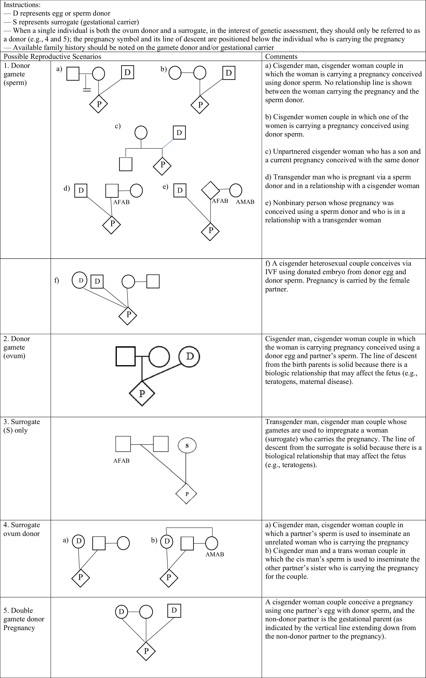
Practice resource‐focused revision: Standardized pedigree nomenclature update centered on sex and gender inclusivity: A practice resource of the National Society of Genetic Counselors
Journal of Genetic Counseling, First published: 15 September 2022, DOI: (10.1002/jgc4.1621)

Slide 10
User’s guide
“Affected” individuals are those with a specific phenotype
Typical Mendelian inheritance presents a few possibilities:
Autosomal dominant
Autosomal recessive
X-linked dominant
X-linked recessive
Y-linked

Slide 11
Autosomal dominant
No preference for either sex
Two affected parents may have unaffected offspring (if they’re both heterozygous)
Trait does not skip any generation
Notes:
Could this be something else? (Yes! Autosomal recessive)

Slide 12
Autosomal recessive
No preference for either sex
If both parents are affected, all children will be affected
Can skip generations and unaffected parents can have affected offspring
Notes:
Could this be something else? (No, since it skips generations and an affected woman has unaffected son)

Slide 13
X-linked dominant
Affected man will produce 100% affected daughters, no affected sons
Affected mother will have 50 or 100% of offspring affected
Trait does not skip any generation
Notes:
Could this be something else? (Yes! Autosomal dominant, autosomal recessive)

Slide 14
X-linked recessive
More prominent in males
Affected father will only have affected children if their mother is a carrier, but all his daughters will be carriers
A carrier mother will have 50% affected sons (can skip generation, sons have same phenotype as their maternal grandfather)
Affected mother (uncommon) produces 100% sons affected, all daughters are carriers

Slide 15
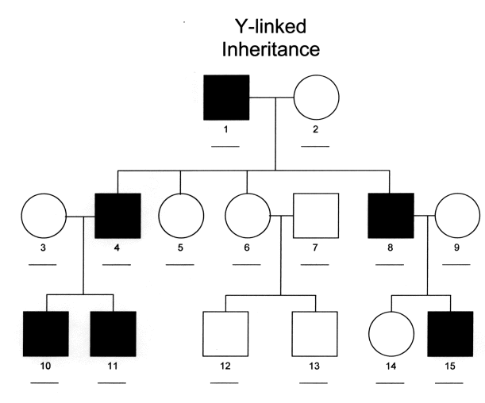
Y-linked
All males are affected and pass it on to all male offspring
migrc.org
Notes:
Ended mar 28 here

