Slide 1
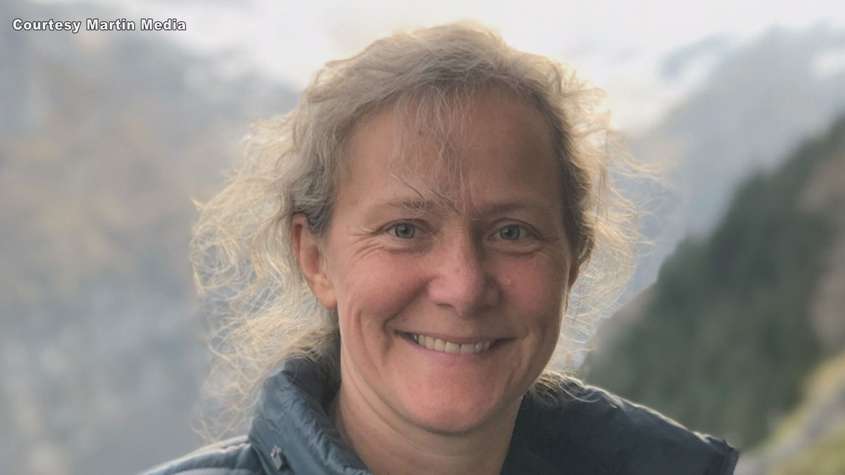
TRISTAN
AGE | 52-year-old
JOB | Administrator at local high school
BIO | Patient diagnosed with ALS – Lou Gehrig’s disease 3 months ago Patient’s symptoms started in the limbs – muscle twitching and weakness Patient first noticed symptoms playing weekly hockey game with friends After seeing specialist, diagnosis of ‘limb-onset ALS’ was given Referred for follow up at home Has had an initial evaluation completed in a clinic but prefers home follow up with Physiotech and Social Work tech
PSYCHO | Very upset Extremely down due to life-altering disease Losing autonomy Scared about dying and when it will happen
SOCIAL | Very supportive family Married with 3 children Parents of patient still alive and well. Siblings live in Montreal
TEAM | Intervention is being completed at their home
GOOGLE IMAGE

