Slide 1
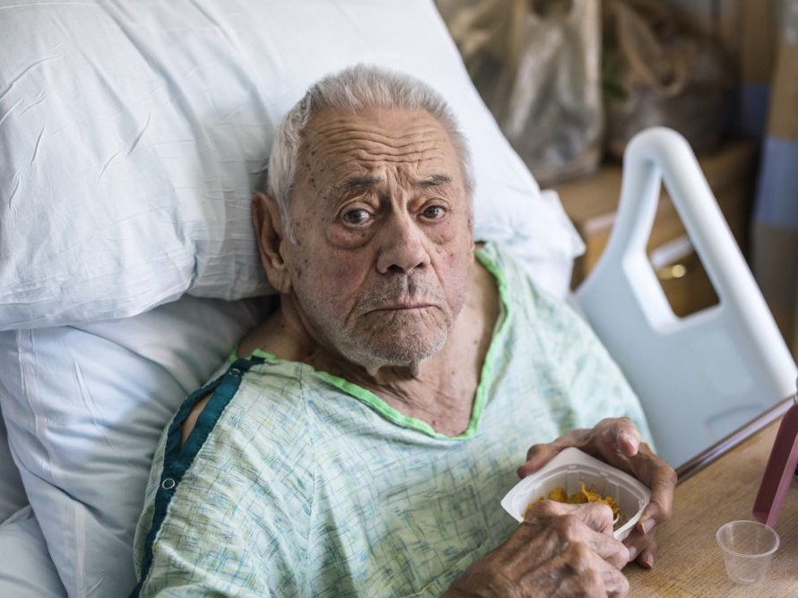
Interprofessional Education Procurement issues

Slide 3
Learning Objectives
To learn about each discipline’s role within the process of procurement
To learn about common missteps in the process from each other
To generate a list of possible ways to mitigate and navigate the missteps by collaborating together

Slide 4
TODAY
Time | Activity | Learning Objectives | Learning Outcomes
8:00 – 8:20 | Icebreaker | To get to know each other | Be able to identify your multidisciplinary group
8:20 - 8:40 | Case presentation and overview of material | To learn about Mr. Johnson | Be able to identify possible missteps within the case
8:40 – 8:55 Pink form 8:55– 9:45 Yellow form | Small group work – Pink form and yellow form Role plays | To hear about each discipline's role within the process To brainstorm solutions regarding possible missteps within the process | Be able to identify commonalities and differences in each other’s roles within the process
9:45 - 10:00 | Break
10:00 – 10:20 Yellow form | Continue yellow form | To brainstorm solutions regarding possible missteps within the process | Be able to identify commonalities and differences in each other’s roles within the process
10:20– 10:45 | Consolidation | To exchange on some of the controllable factors in the process | Be able to identify ways to mitigate and navigate missteps

Slide 5
Mr. Johnson

Slide 6
Mr. Johnson
Mr. Johnson, a 65-year-old male with a history of hypertension, presents to the emergency department (ED) with severe chest pain. Suspecting a possible myocardial infarction (heart attack), the ED nurse initiates an electrocardiogram (ECG) and collects blood samples for cardiac enzyme tests, electrolytes, and a CBC.
Script starts with Mr. Johnson interacting with the nurses.

Slide 8
TEAM TIME

Slide 9
Complete pink form 15 minutes

Slide 10
Complete yellow form 50 minutes

Slide 11
BREAK TIME 15 minutes

Slide 12
Finish yellow form 20 minutes

Slide 13
Consolidate 25 minutes

