Slide 1
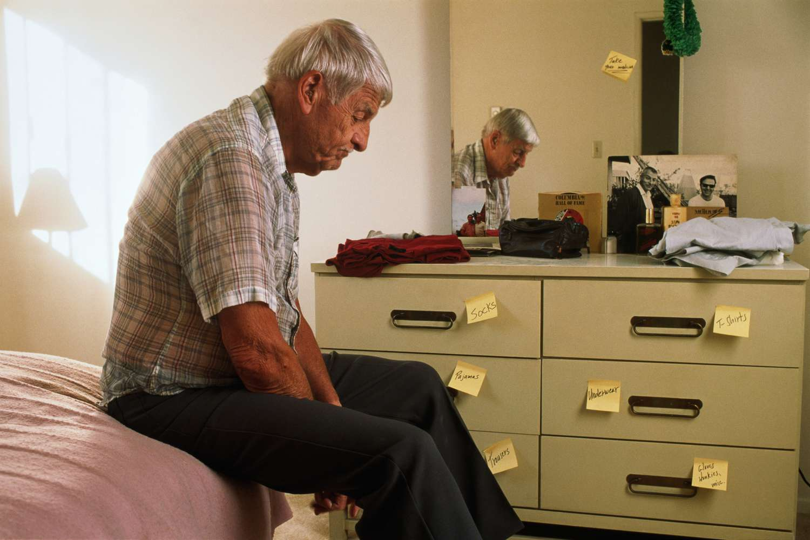
IPE - Team Functioning and Motivational Interviewing

Slide 2
Learning Objectives
To apply your team functioning skills learned from our first session
To apply your motivational interviewing skills learned in your discipline specific courses
To intervene with a client, Giovanni, in their home

Slide 3
TODAY
Time | Activity | Learning Objectives | Learning Outcomes
1:00-1:30 | Welcome | Bridge information from Team Functioning workshop and MI lessons | Be able to recall key concepts of both TF and MI
1:30-1:40 | Break out into small teams and case preparation
1:40-2:10 | Round 1 | First group completes intervention with client in their home | Be able to use MI and TF skills successfully or identify moments where skills would have been used
2:10-2:40 | Round 2 | Second group completes intervention with client in their home | Be able to identify commonalities and differences in each other’s roles within the process
2:40-2:55 | 15-minute break
2:55 – 3:25 | Round 3 | Third group completes intervention with client in their home | Be able to identify commonalities and differences in each other’s roles within the process
3:25-3:45 | Consolidation | To exchange on some of the key takeaways from each group | To create a list of tools for toolkit

Slide 5
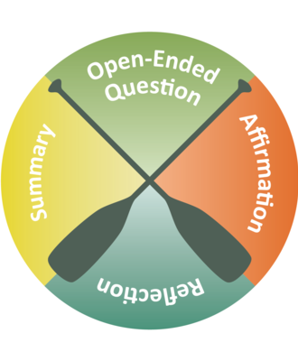
Week 3: Motivational Interviewing Principles in interventions with mandated adult clients

Slide 6
Resistance: A Person’s Key Barrier to Change
Definition:
5 Types of resistance
Resistance is: the refusal to accept or comply with something; the attempt to prevent something by action or argument
Attitudinal
Relationship
Motivational
Fearful
Involuntary

Slide 7
9 Ways of expressing resistance (Shebib Ch. 8)
Failure to comply
Closed Statements
Passivity
Diversion
Subtle Undermining
Uncooperative behavior
Creating an illusion of work
Passive / Aggressive
Limiting ( the scope of discussion)
Notes:
(Shebib, ch. 8)
Failure to comply with the basic procedure of counselling such as keeping appointments, being on time, court order
Closed Statements that indicate resistance (i.e. this is a waste of time, it’s none of your business, I do not want to be here)
Passivity (silence, withholding information, persistent short answers
Diversion (i.e. changing the subject, using excessive humour, making small talk, introducing irrelevant material, being overly talkative, intellectualizing)
Subtle undermining (i.e. attempting to redefine the worker/client relationship as a friendship, excessively praising, being sarcastic)
Uncooperative behaviour (failure to follow through with plans)
Creating the illusion of work (engaging in conversations that appear important but have no meaning
Nonverbal cues suggesting passive/aggressive response, such as not making eye contact, folding arms, sitting on the edge of the seat, using an angry tone of voice, clenching fists, raising eyebrows, frowning and sighing
Limiting the setting (restricting discussion on certain topics by insisting the topics are irrelevant)

Slide 8
4 categories to help you spot Spotting Resistance:
Arguing
Challenging
Talking over
Denying
“ I was sick”
“ It’s my parent’s fault, I am like this.”
“ It was Jim’s birthday, we all had too much to drink. Okay, so we got out of hand, you know how it is?
“My Friends Forced Me”
Admitting Fault
“ It was a one time thing, I swear, I will never do it again”
Discounting/ Indifference:
Hostility
Cutting off
Excuses/
Ignoring
Inattention
No response
Side tracking
Minimizing
Unwillingness to change
“ They are always saying that, it’s not true”
“It is no big deal”
“ It doesn’t bother me, so I don’t see the problem.”
Blameless or blaming
“ I don’t think I need to change…”
Notes:
Shebib Ch. 8

Slide 9
Internal Barriers to motivating mandated clients
Fear of change
Personality
health
substance abuse
Self-sabotage
motivation
mental illness
comprehension

Slide 10
Gordon’s 12 Road Blocks to communication
Ordering (leads to power struggles)
“You Must “;
Warning or Threatening (leads to resentment/ resistance)
“If you don’t then..”; “You’d better or…”; “You need to stop that”
Advising, giving solutions, suggestions (leads to a negative attitude or dependence)
Moralizing, Preaching, Shoulds and oughts (Leads to defensiveness)
“ What you should really do is …;”
“You Have to..”;
You will, or .”
“Ya know, you ought to..”;
“ It is your responsibility to..”
"What I would do is...,"
"Why don't you...,"
"Let me suggest..."
Using Logic, Arguing (Leads to defensiveness/lying or feeling belittled)
"Doesn't it make sense that if...,
" "Here's where you're wrong...,"
"The facts are..."
Criticizing, Judging, blaming ( Leads to stonewalling or defensiveness)
"You aren't thinking clearly...,"
"You have nobody to blame but yourself...,"
"I couldn't disagree with you more..."
Notes:
Ordering makes the other feel like a child, power struggle btwn worker and self
Warning creates resistance/ resentment, push back “ Who are you to say..”
Moralizing can create defensiveness, resistance, feeling that the worker does not trust their client’s judgements/ abilities, does not accept their world view/ experience
Advising: creates an I don’t care Attitude , or dependency or resistance, lack of confidence in their abilities to problem solve, or think the ssw thinks they are unable to problem solve
Using logic: Person may get defensive, lie or go to great lengths to distort facts, they may feel belittled,
Criticizing, can cause counter attack of criticism, shut down the conversation, defensiveness, hostility

Slide 11
Gordon’s 12 Road Blocks continued
Praising, Agreeing, Supporting (Leads to avoiding the issue, or feeling manipulated)
Labeling, Name-Calling, Ridiculing (leads to defensiveness, lack of empathy)
"You're being a worry-wart for nothing...,"
Reassuring, Sympathizing, Consoling (Can lead to lack of empathy, avoidance)
You're just trying to...,"
"Don't worry...,"
Questioning, Probing, Interrogating (can convey blame – “Why Qs”
"Why did you do that?...,“ “How come?”
"I think you did exactly the right thing!"
"I couldn't agree more...,"
“ Oh I know, The same thing happened to me..."
"You men/ women. kids always think or react...,"
"Okay, Miss Know-It-All..."
Analyzing, Interpreting, Diagnosing ( Leads to shame, embarrassment, lack of empathy)
"What your problem is...,"
"You probably feel that way because...“
"Look on the bright side..."
"Everyone goes through this..."
"And then what did you say?...,"
“You let your supervisor know, right? “
Avoiding, Diverting, Ignoring ( Can lead to rejection, showing you fear the client)
“ I can see this is uncomfortable, let’s just skip it and move on”
Other examples?
Notes:
https://www.gordonmodel.com/work-roadblocks.php
Praise: Can feel manipulated. Can be meaningless, unless you state very concrete reasons for the praise. You cannot just say “|that’s amazing,” you need to say why. People can become dependant on the praise and also fail to tell you when they are doing poorly, for fear of feeling ashamed or you feeling ashamed or disappointed in them.
Labelling : micro aggressions or macro that cause defensiveness. Client does not believe you have empathy for them
Analyzing/ interpreting: Can feel threatened, not listened to, embarrassed, aggravated. Lack of empathy on the part of the ssw, lack of full understanding of feelings.
Reassuring and sympathy- tells the clients you cannot tolerate their negative feelings, you are afraid of their feelings and ignoring them. This is not a safe space to talk anymore. Or that you feel sorry for them, based on your own beliefs and feelings about the situation.
Probing: can convey blame- avoid the why questions. It is necessary to ask the closed questions at times, for clarity. It is overwhelming to be interrogated, uncomfortable and can convey that you are only listening for what you want to hear, or that you are trying to take over the problem solving process
Avoiding/ ignoring: This can convey a lack of respect for the client or for others whom the client has hurt. It can convey a fear of the client’s feelings/ actions. It can make people feel angry, rejected or hurt. It can also show that you cannot handle these emotions.

Slide 12
What Involuntary Clients May Feel and What They May Be Thinking
FEELS | THINKS
Angry | Screw you! You can’t make do this. What power do you have over me? How can you possibly understand how I feel
Afraid | I won’t do this! I will lose __ my relationship, my home, my autonomy, my children, my freedom. I don’t want to be sober or go to counseling and have to feel all of these negative feelings
Powerless | Ambivalent, maybe you CAN help, I don’t think I can help myself. I have 2 choices do it or else
Guilt | There is nothing I can do to make this better, I give up. I should have never done that/ How could I have done such a thing?
Shame | I cannot face the person I hurt. The person I hurt, or My family will never forgive me. I know better, how did I get myself into this mess.

Slide 13
What Workers May Feel and What They May Thinking
FEELS | THINKS
Uneasy | I don’t want this client I disklike them for what they have done. I am afraid of them. I feel manipulated by them.
Rejected | They don’t trust me. They don’t want to be here. I am just another worker trying to tell them what to do. They don’t like me.
Inadequate | I don’t know when to intervene I don’t know how to convince them they need to do this step. I don’t know what the court outcome will be so how can I help them?

Slide 14
Considerations when clients do not follow through with changes necessary as part of the mandated intervention plan (part 1) (Giniac, M., 2015, Institut Pinel)
Difficulties | Examples of non resolved problems
With Transitions | Too fast, too many transitions at once (people, places, tasks), fear of change, fear of being alone
Following logical order | i.e. In a shelter- before bed takes a shower, then eats, then cannot sleep
Perseverance with difficult or unwanted tasks | Fear of failure? Fear of success? Not knowing how to do something? Feelings coerced.
Time management | Arrives late to work and loses their job (mandatory for probation)
Reflecting on many things at once | Overloaded with information? Difficulty prioritizing- what is the most important when everything is important/urgent?
Concentration | Anxiety? ADD? Lack of sleep? Drugs/ alcohol? Cognitive problems?
Considering consequences of their actions. | Poor impulse control? Age related perceptions of time and or danger? Lack of experience?
Considering possible solutions to a problem | Learned helplessness? Lack of experience?
Expressing emotions | Naming emotions, understanding what triggers them
Over-focused attention | Obsessing, compulsive behavior to self soothe, inappropriate social skills
Notes:
intellectual disabilities, mental health or lack training

Slide 15
Difficulties (Part II) | Examples of non resolved problems
With verbal or written comprehension | Language barriers, hearing problems, reading problems, writing problems, education, word processing problems ( too fast )
Managing emotions/ frustrations | Understanding triggers, reacting in patterned rigid ways, low distress tolerance or accumulated stress
To read between the lines | Unable to read non- verbals/nuances/ tone of voice, culturally foreign expressions
With barriers, ambiguity, uncertainty | Fear, learned helplessness, lack of experience, fear of making the wrong decision, uncertain outcomes, previous experiences of oppression
Understanding factors which indicate a change in the plan of action is needed | “If this happens, I need to do xxxx” “If I do this, this may happen, then I will need to change…” “These behaviors are going to make the situation worse/ better?
Rigid cognitive interpretations All- or- nothing ; generalization | “ I am nothing”; “ everyone thinks I can’t do it”; “ Nothing will get better”
Reading social cues/ non verbals | Matching facial expressions and personal space with emotions
Social skills deficits in groups, and how behavior affects others | How to start / end a conversation, interrupting, leaving too soon, starring, laughing or self disclosure at inappropriate times,
Showing empathy for others | Difficulty taking another person’s perspective, esp.. Authority or someone who does not have the same lived experience
Understanding how others perceive one’s behavior | Tone of voice, non verbals, verbals, aggression, withdrawal, silences, etc.

Slide 16
MI is Based on the Trans- theoretical Model of Change

Slide 17
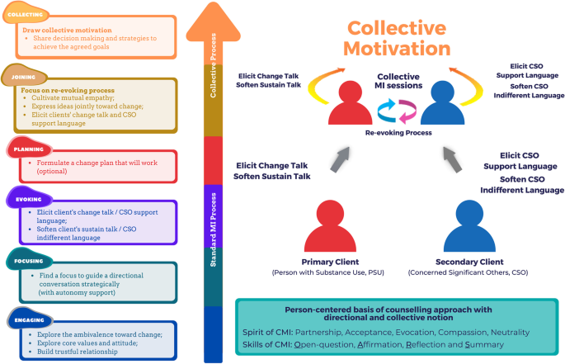

Slide 18
6 Steps for Dealing with Involuntary Clients
Clear the air
Legitimate client interests
Non-negotiables
Negotiate the case plan
Negotiate aspects of intervention
Monitor change and termination
Notes:
Memorize this Folks!
Use the case of Robbie here role play it.
Clear the air
Set the stage of negotiation – i.e. court order, protection of children, drug related offenses. Encourage the client to express their feelings and thoughts about the situation. WORKER: use reflective listening skills. AIM: begin to deal with the emotional content of conflict
Identify legitimate client interests
inquire about the resistance, reasons. What does the client stand to lose?
Non-negotiables
What is the basis of interventions?
Negotiate where appropriate
Agree on the bottom line

Slide 19
Use your basic Skills
Facilitating; empathic skills
Validating feelings
Honesty
Re-Framing resistant behaviour
Giving client ownership
Challenge- Confront, or use scales- Intensification of discomfort
Self-determination
Notes:
Validate that they are entitled to opposition
Honesty about your authority, who you are and the limits of what you can do. Be honest about consequences and upfront
Frame behaviour as situational vs. personality
Find a problem which the client can assume ownership
For the client in the present situation
Intensification of discomfort, do not veer too much away from the real issue
Self determination- where do they want to start? Versus where does the court want to start? Is there a happy medium? One valid choice is not being ready and not doing.

Slide 20
Responding to Change Talk OARS- the cores skills of MI
Open-ended questions:
Ask for more detail or examples to understand the person’s internal frame of reference and feelings, and to strengthen the collaborative relationship.
Affirmations:
Comment positively about what you heard. This is a direct recognition of particular strengths, abilities, insights, good intentions and efforts of the client.
Reflections: They can be simple or complex
Allows people to hear again the thoughts and feelings they are expressing and ponder them
Keeps the person talking, exploring, and considering
Clarify what the client means, their stage of change and level of commitment
Summaries:
Pull together all the information at the end of a session
Include pros and cons and change talk content in summaries
Suggest links between present and past material
Function to transition from one task to another
Provide a ‘what else?’ opportunity

Slide 21
Evoking Skills: Recognizing Change and sustain talk
Change talk : When you hear the person’s own statements that favor change, self-motivational statements.
Maybe… that might work…
I guess we could try.
Of all the options, this one seems doable
I want to..
I think I can..
I am not sure how, but I would be willing to try….
Sustain talk ( Ambivalence )
When you hear the persons own arguments for not changing, and for maintaining the status quo.
“ Yeah, but…”
“ I am not going to totally stop drinking, I would have no friends/ life”
“I tried before, it never works”
So I get out of jail and then I am back in the same situation, it’s hopeless.”
Why should I have to do all the work, they started this mess.
Sustain Talk
Change Talk
VS.
Notes:
https://www.youtube.com/watch?v=KOS2057HUUE DARN CATS video 6 min

Slide 22
The DARN CATS: Language that signals the client’s movement toward change
Desires:
Ability:
Reasons :
Needs:
Commitment:
Activation-
Taking steps:
What is the client’s preferred outcome(s)?
What skills, strengths or previous successes can they use to overcome this?
What is important to them ( family, friends, housing, jobs/ school, working through emotions, respect, freedom, etc.)?
What to do they need to get to where they want to go?
What do they need emotionally, physically, spiritually, socially?
Can they state they want to commit to the intervention plan?
What are barriers to commitment?
What stage of change are they in right now?
What steps can they propose?
What steps are they interested in , that you or other people who are important to them have proposed?

Slide 23
DARN: Listening for and using Questions to Elicit Change Talk
Desire
SSW: “How would you like for things to change?”(Open)
Client: “ It seems pointless, but I wish things were different and I could just start over”
Ability
SSW: “Of these various options you’ve considered, what seems most possible?” (reflection)
Reasons
Need
SSW: “What are you thinking about , when you consider starting in over again?” ( reflection)
SSW: How serious is this to you?”(reflection) OR “What do you need to make this work? (open)
Client: “ I guess I could move in with my friend who doesn’t use drugs, or ,go to detox, get a job, stop seeing my partner. It is all so overwhelming, but I have done it before.”
Client: “ I don’t want to go to jail again. If I have a bigger criminal record, I won’t be able to find a job and I will be alone. What would I do with my dog? “
Client: “I am afraid of losing everything again. It is so hard to stay motivated when everything is falling apart around me. No one around me believes I can do better.. I can’t do this alone.

Slide 24
CATS: Recognizing The client’s Change Talk
Commitment: signals the likelihood of action ( Use affirmations, open ended Questions)
“I will try to …”;
“I promise to…”;
“I intend to…” (decision with a little doubt)
Activation: movement toward but not quite a commitment
( Use open ended questions and summaries to help them understand their plans)
“I’m willing to try…..”;
“I am ready to….”;
“I am prepared to….”
Taking Steps: Actions they have done
(Help the client evaluate using scales/ upside/ downside questions and affirmations)
“I went to AA”;
“I showed up for my appointment”;
“I quit doing/ taking …..”
“ I tried….”
“I guarantee, I will..”;

Slide 25
Giovanni
Your task
As a team, intervene with Giovanni in his home
Follow your cheat sheets to help prepare for intervention
Each role play is 20 minutes
Students who are not completing role play are tasked with providing feedback during debrief
OARS
Team functioning and Gordon’s Roadblocks
Journey scenario

Slide 26
Consolidation

Slide 27
References
Gignac, M. (2015) Conference handout: Considerations when clients do not follow through with changes necessary as part of the mandated intervention plan. Montreal, Institut Pinel.
Miller, B. (2011) Anger Management working with clients through a 10 step process. Toronto: Hincks Dell Crest Centre.
Miller, WR and Rollnick, S (2012). Motivational Interviewing: Helping People Change (3rd Ed.). New York: Guilford Press.
Walters, S. T. ; Clark, M.D. ; Gingerich, R.; Meitzer, M.I. (June, 2007). Chapter 6. Navigating Tough Times: Working With Deception, Violations, and Sanctions. A Guide for probation and parole: Motivating offenders to change. National Institute for Corrections, US Department of Justice.
Young, K. Duvall, J. ( 2014) Narrative Therapy Put Simply, Understanding Narrative Practice. Toront: Hincks Dell Crest Centre.

