Slide 1
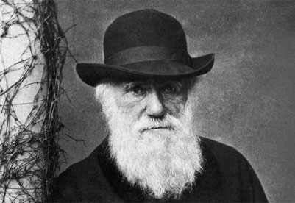
Evidence of evolution and Natural Selection

Slide 2
1) A farmer uses triazine herbicide to control pigweed in his field. For the first few years, the triazine works well and almost all the pigweed dies; but after several years, the farmer sees more and more pigweed. Which of these explanations best describes this observation?
Natural selection caused the pigweed to mutate, creating a new triazine-resistant species.
Triazine-resistant pigweed has less efficient photosynthesis metabolism.
The herbicide company lost its triazine formula and started selling poor-quality triazine.
Only triazine-resistant weeds survived and reproduced, so each year more pigweed was triazine-resistant.
[Default]
[MC Any]
[MC All]
Notes:
Answer D

Slide 3
2) A farmer uses triazine herbicide to control pigweed in his field. For the first few years, the triazine works well and almost all the pigweed dies; but after several years, the farmer sees more and more pigweed, no matter how often he applies triazine. Which of these actions is most likely to solve the farmer's problem?
trying a different herbicide
increasing the amount of triazine he puts on his fields
buying triazine from a different company
adding triazine more often to his fields
[Default]
[MC Any]
[MC All]
Notes:
Answer A

Slide 4
3) Parasitic species tend to have simple morphologies. Which of the following statements best explains this observation?
Parasites are lower organisms, and this is why they have simple morphologies.
Parasites have not yet had time to progress, because they are young evolutionarily.
Simple morphologies have been naturally selected for in most parasites.
Parasites do not live long enough to inherit acquired characteristics.
[Default]
[MC Any]
[MC All]
Notes:
Answer C

Slide 5
4) In several Arizona populations of the pocket mouse, mice on light-colored granite had lighter colored coats than those on dark volcanic rock. Which of the following hypotheses best explains this observation?
Dark coats in mice living on volcanic rock are an adaptation for camouflage.
Dark coats in mice living on volcanic rock are an adaptation for attracting mates.
Dark coats in mice living on volcanic rock are an adaptation for UV protection.
Dark coats in mice living on volcanic rock are an adaptation for improved heat absorption.
[Default]
[MC Any]
[MC All]
Notes:
Answer A

