Slide 1
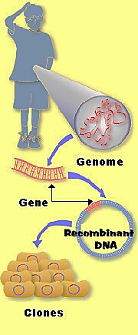
Cloning of Human Insulin Gene Class Activity

Slide 2
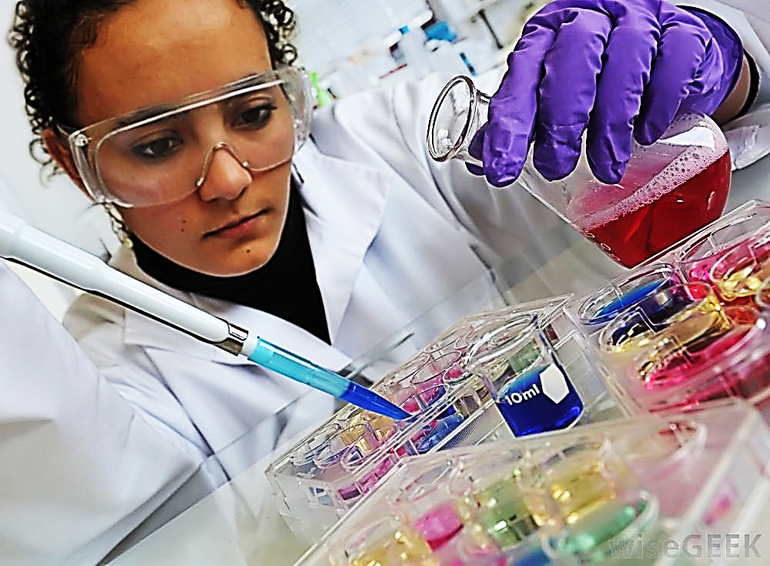
You are a molecular biologists in a pharmaceutical company. You were assigned to a team of scientists working on a gene cloning project. Your role is to help produce a transgenic strain of E. coli capable of mass-producing the human form of the hormone insulin.

Slide 3
Question 1
To start preparing for the project, you did a bibliographic research to learn more about insulin. In one of the references, you read that before the advent of recombinant DNA technology, the insulin required to treat diabetes was obtained from the pancreas of slaughtered animals. What are possible problems associated with the use of animal insulin in humans? (3 min)
Notes:
Reduced efficiency due to different amino acid sequence.
Immune or allergic reactions due to the introduction of foreign protein into the body

Slide 4
Question 2
In preparation for the project, you make a list of the molecular and cellular tools needed to clone human insulin and make E. coli mass-produce this hormone. What would this list be? (3 min)
Notes:
Restriction enzymes
Ligase
Plasmid DNA or other vector
Human mRNA
Reverse trasncriptase
Host cell (E coli)
Marker genes
Human insulin gene probe

Slide 5
Restriction enzymes
Ligase
Plasmid DNA or other vector
Human mRNA (why not DNA?)
Reverse transcriptase
Host cell (E. coli)
Marker genes
Human insulin gene probe

Slide 6
Question 3: In your first team meeting, the initial steps in cloning the human insulin gene were presented. Several ideas were discussed (included in the list below). Which of these 4 approaches would you choose? Explain why.
Isolate human DNA from beta cells of human pancreas.
Isolate cDNA from beta cells of human pancreas.
Isolate insulin itself from beta cells of human pancreas.
Isolate all mRNAs produced by beta cells of human pancreas.
[Default]
[MC Any]
[MC All]
Notes:
D

Slide 7
Question 4
An intern on your team does not understand the reason for using reverse transcriptase in the protocol. She asks you for clarification. How would you explain the role of this enzyme in the cloning protocol to her? (2 min)
Notes:
Used to convert RNA to cDNA so that cDNA can be inserted into plasmid DNA.

Slide 8
Question 5- Part 1
As part of the cloning protocol, recombinant DNA technology is used in order to produce a recombinant plasmid. Which molecular tools are needed in order to produce such a plasmid? (2 min)
Notes:
Restriction endonucleases and DNA ligase

Slide 9
Question 5-Part 2: And what DNA segments would it contain?
Draw the plasmid and label the different DNA segments needed to be part of the cloning vector.
Notes:
Ask to do this before next clicker question and then after

Slide 10
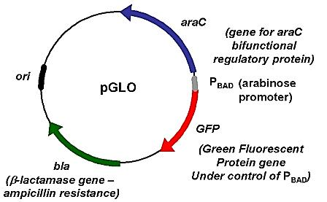

Slide 11
Question 5-Part 2: And what DNA segments would it contain?
A cDNA
A promoter sequence upstream of cDNA
Ori
Marker gene
All of the above
[Default]
[MC Any]
[MC All]
Notes:
E

Slide 12
Question 6
The initial steps in producing insulin biofactories involve bacterial transformation, in which bacterial (eg, E. coli) cells are subjected to a treatment that would facilitate the uptake of plasmids by these cells and their incorporation into their cytoplasm. In this process, not all bacterial cells pick up the recombinant plasmids. What method would you use to isolate cells that picked up plasmids? (3 min)
Notes:
Use of marker genes in the plasmids (e.g., gene for resistance to antibiotics).

Slide 13
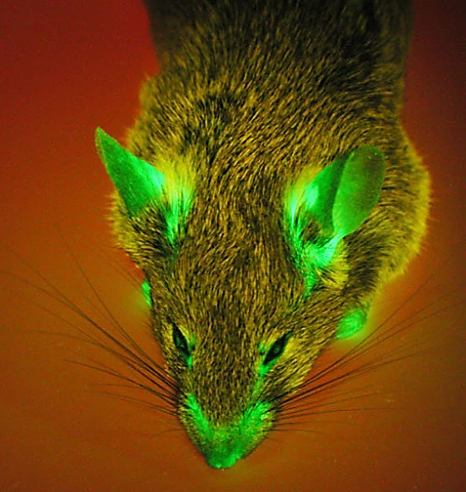
Marker (reporter) genes
Selectable (β-lactamase)
Screenable (GFP)

Slide 14
Question 7: To help the intern understand the previous step, you give her the following problem to answer. The figure below shows a piece of foreign DNA being inserted into a plasmid. amp^{r} and tet^{r} are genes that code for resistance to the antibiotics ampicillin and tetratcycline. If E. coli is allowed to take up this vector and then plated on a medium that includes only tetracycline, which of the following will die?
E. coli that have taken up the foreign DNA alone (not in the plasmid) and intact plasmid (no foreign DNA inserted).
E. coli that have taken up the plasmid with the foreign DNA inserted in the plasmid as shown in the figure.
E. coli that have not taken up anything
Both A and B
Both B and C
Notes:
E

Slide 15
Part II of Question 7: Because bacteria replicate so easily, you can test some of your E. coli in the experiment just described and still have plenty of identical E.coli left over to test again. How will you isolate E. coli that has taken up a plasmid with the foreign DNA?
Incubate the E. coli with both ampicillin and tetracycline
Incubate the E. coli with just tetracycline
Incubate the E. coli with just ampicillin
None of the above
Notes:
C

Slide 16
Question 8
To identify the bacterial colonies containing a plasmid with the insulin gene, a DNA probe was constructed based on the insulin amino acid sequence. To help the intern understand this step, you give her the following problem to solve.
“Assume that the following polypeptide chain is produced by a gene in an organism:
N-Met-Lys-Trp-Leu-His-C
Using the genetic code, you construct an artificial DNA sequence based on the peptide chain above. Write your DNA sequence and label the 5’ and 3’ ends.” (5 min)

Slide 17
mRNA:
5’ AUG AAA UGG UUA CAU 3’
CUU
mRNA → cDNA → DNA probe
DNA probe:
5’ ATG AAA TGG TTA CAT 3’
CTT

Slide 18
Question 9: Not all bacterial cells pick up the recombinant plasmids containing human insulin cDNA. What method is used to isolate cells that picked up these plasmids only?
Use a radiolabelled single-stranded DNA probe to insulin gene
Use a radiolabelled double-stranded DNA probe to insulin gene
Use hybridization technique to locate colonies that picked up the recombinant DNA containing insulin cDNA
Both A and C
Both B and C
[Default]
[MC Any]
[MC All]
Notes:
D

Slide 19
Question 10
Once the transgenic bacterial colonies are identified, they are cultured in large numbers to mass-produce insulin, which is then extracted, purified, and stored in a stable solution for use in the treatment of diabetes. Your intern student appreciates the practical aspects of recombinant DNA technology and genetic engineering, and is wondering whether these techniques can be used to clone and mass-produce other human proteins. How would you answer her question? (3 min)
Notes:
Probably not for proteins that need to be processed post-translationally before they assume their active form.

Slide 20
Question 11: Tools for gene manipulation
Action | ‘Tool‘
Cut DNA into fragments at precise locations
Separate fragments by size
Find particular DNA fragments
Join DNA fragments
Transport DNA into cells
Obtain multiple copies of gene

Slide 21
Question 11: Tools for gene manipulation
Action | ‘Tool‘
Cut DNA into fragments at precise locations | Restriction enzymes
Separate fragments by size | Electrophoresis
Find particular DNA fragments | DNA probes
Join DNA fragments | Ligase enzyme
Transport DNA into cells | Vectors (eg, plasmid)
Obtain multiple copies of gene | Gene cloning (eg, via bacterial transformation)

Slide 22
Question 12
Construct a flowchart that depicts the main steps involved in cloning human insulin gene. (10 min)
Notes:
Isolate mRNAs from pancreatic tissue → reverse transcribe mRNAs into cDNAs → attach restriction sequences to all cDNAs → cut cDNAs and plasmids with same restriction endonuclease → mix digested cDNAs and plasmids and treat them with DNA ligase to form recombinant plasmids → transform E. coli cells with recombinant plasmids → grow transformed cells on media containing an antibiotic → lay over a filter to pick up cells from the growing colonies → treat filter with chemicals to make cDNAs single-stranded → incubate filter with insulin DNA probe → locate colony that hybridized with insulin DNA probe

