Slide 1
Review Olga case #1
https://docs.google.com/document/d/12Li4fCU-OTjSI6izZWVUK5QPaltlxclYcVAr2HjAs4c/edit
Notes:
Note to teacher: students have seen the case and answered a g-quiz about it prior to coming to class in which the questions are listed on the case document and equivalent (approximately) to the questions they will go through in small groups during class.

Slide 2
Group discussion
Key information - deciphering relevant details
How do we approach a case in cardiorespiratory conditions? What are indicators of improvement or deterioration in vascular case (compared to ortho?)
Ortho case | Vascular case
Notes:
In-class teacher guided discussion drawing on prior knowledge: students are familiar with how to approach an ortho case - have them call out indicators they would pull from the case to determine improvement or deterioration of the client. Then, together, see which items are also considered for a CR case (and whether the priority or focus/data is different). Then consider other variables not considered in ortho cases. Why do we need these indicators? What is the difference between these two systems?

Slide 3
Theory bullet:
Teacher review congestive heart failure
-interactive mini-lecture on whiteboard
Notes:
In-class teacher diagram manually drawn on whiteboard outlining most impt s/sx that WE monitor for in physio with CHF patients as potential signs of unstable or destabilizing condition: (and WHY) - review direction of bloodflow, pump function, where blood backs up, clinical reality of R vs LCHF - usually we don’t know which, only CHF is indicated on chart, clinical consequence = need to monitor for both, discussion on how to do that, and destabilization over days (congestion s/sx) vs sudden dec in CO (mostly s/sx to do with blood getting to the head - sudden drop in BP, pallor, sudden/severe fatigue/weakness, dizziness or syncope

Slide 4
Category: And the survey said….
Instruction: choose (highlight) one category, based on 3 colleagues’ responses
Cat 4: “Although her referral is for improving her deconditioning, her med is changed and she missed her cardiologist visit. We don't know if her cardioresp status is stable.”
Category 3: “controlled disorder (with meds), but her geriatric profile requires investigation as they are unsure of the etiology of the fall. Dizzy spells have not occurred since, meaning there has not been an acute incident since.”
Category 1: “Pt is seeing physio in order to recover functional autonomy from before hospital visit. No new dx from cardiologist. Pt’s condition is stable and medications have been adjusted.”
Notes:
Answers pulled from open-ended questions in the case, completed as preparation for this activity.
Discussion: Nuance/grey areas - how is stability defined and by whom? Look at institutional decisions, look at TIME since discharge, changes since last information was available, when in doubt….?
If we are not sure, what extra information can we get to support our decision?
Share my own clinical decision and reasoning behind it…

Slide 5
What is missing from the case S/chart review?
Let’s rank YOUR answers in terms of importance regarding SAFETY!
8
9
Smoking history?
Coughing history - more details? Which ones?
pt's activity participation
Hx of falls and circumstances surrounding them (e.g. 1st time for fainting?)
Hobbies/activities
Hx of chest pain
More details about SOB
Sleep interruptions
How far is the dining hall from her apartment?
More details about dizziness?
4
7
3
2
1
5
6
10
Notes:
Discussion: Reasons for prioritizing certain elements: urgency vs contextual information that will help us plan
“Need to know” (Now vs later)
Nice to know (will it help set goals? Not essential information, but will help with decision making regarding treatment priorities, discharge, etc.)

Slide 6
What is missing from the case S/chart review?
Let’s rank YOUR answers in terms of importance regarding GOAL SETTING!
8
9
Smoking history?
Coughing history - more details? Which ones?
pt's activity participation
Hx of falls and circumstances surrounding them (1st time for fainting?)
Hobbies/activities
Hx of chest pain
More details about SOB (visual analog scale or CAT (validated for COPD only though)
Sleep interruptions
How far is the dining hall from her apartment?
More details about dizziness?
4
7
3
2
1
5
6
10
Notes:
Discussion: Reasons for prioritizing certain elements: urgency vs contextual information that will help us plan
“Need to know” (Now vs later)
Nice to know (will it help set goals? Not essential information, but will help with decision making regarding treatment priorities, discharge, etc.)

Slide 7
What is missing from the case S/chart review?
Let’s rank YOUR answers in terms of relationship to CARDIOVASCULAR RISK
8
9
Smoking history?
Coughing history - more details? Which ones?
pt's activity participation
Hx of falls and circumstances surrounding them (1st time for fainting?)
Hobbies/activities
Hx of chest pain
More details about SOB (visual analog scale or CAT (validated for COPD only though)
Sleep interruptions
How far is the dining hall from her apartment?
More details about dizziness?
4
7
3
2
1
5
6
10
Notes:
Discussion: Reasons for prioritizing certain elements: urgency vs contextual information that will help us plan
“Need to know” (Now vs later)
Nice to know (will it help set goals? Not essential information, but will help with decision making regarding treatment priorities, discharge, etc.)

Slide 8
What is missing from the case “O”?
Find 2 that are INAPPROPRIATE (e.g. not something a phys tech is qualified to do, or will not provide useful information in this case), and rank the other 7 answers from MOST to LEAST important
2
Auscultation
Breathing pattern
Quality/rhythm of pulse
Flowmeter
Recovery time post 6MWT
Peripheral skin temperature
Listen to heart sounds
Measurement of oedema
Cap refill
7
4
5
1
6
3
Notes:
Identifying missing information from the case - what does each of these elements tell us about the patient, and why are they important (focus on top 3 or 4, afterward, ranking matters less….) Remember CHF patho!! What are key s & sx??

Slide 9
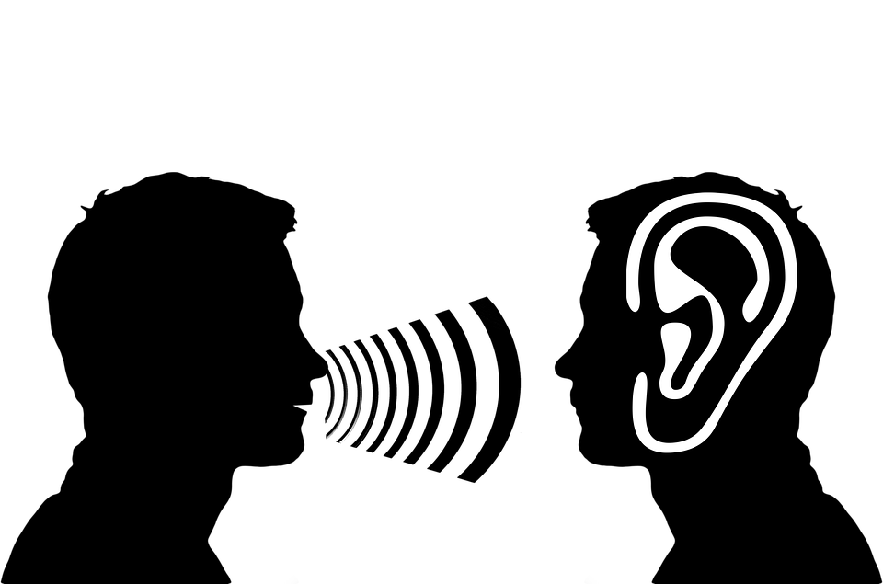
SUBJECTIVE monitoring:
Step 1 - cross out any answers that are NOT subjective info!
Step 2 - Vote on top 3 subjective items to monitor for the case (big happy faces)
Little happy faces = not wrong, but not the best answer
Swelling in feet/lower extremities
SOB
respiratory rate
BORG
Chest pain
weakness
pallor
fatigue
Dizziness
Talk test
coughing
Notes:
Discussion: - importance of each element (esp top 3) - what does abnormality indicate? Potential causes? Ease of monitoring? Can we ask the patient do self-monitor?
nuance in what is “objective” (e.g. talk test? SOB? BORG? Showed up in both subjective and objective answers… Does it matter how we categorize them? Difference between client experience and what we are seeing - sometimes they align, but what if they do not? )

Slide 10
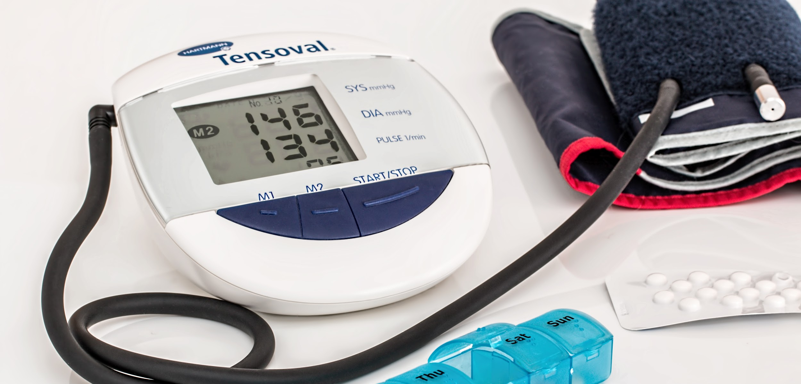
OBJECTIVE monitoring:
Step 1 - cross out the answers that are NOT OBjective or relevant
Step 2 - Then vote on top 3 items to monitor for the case…
Little happy faces = not wrong, but not the best answer
Dizziness
SOB
respiratory rate
BORG
BP
O2 sat
pallor
fatigue
coughing
Talk test
Swelling in feet/lower extremities
Gait
HR
Notes:
Discussion: - importance of each element (esp top 3) - what does abnormality indicate? Potential causes? Ease of monitoring? Can we ask the patient do self-monitor?
nuance in what is “objective” (e.g. talk test? SOB? Does it matter? Difference between client experience and what we are seeing - sometimes they align, but what if they do not? )

Slide 11
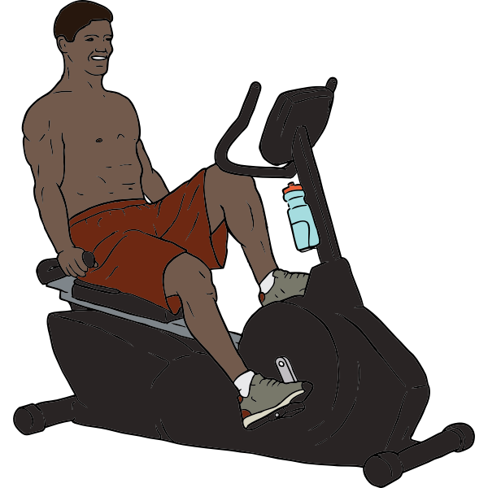
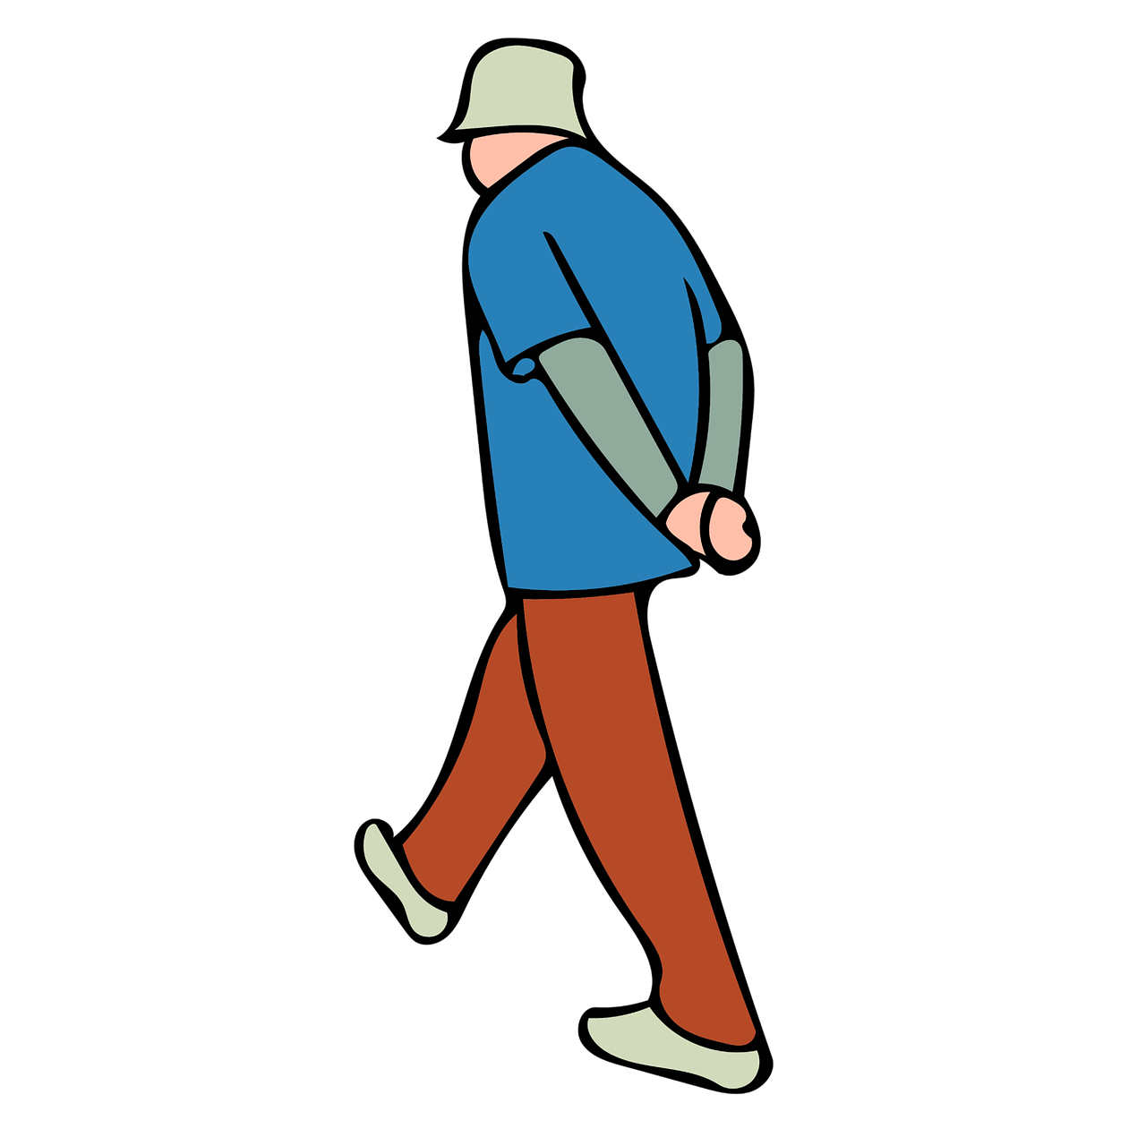
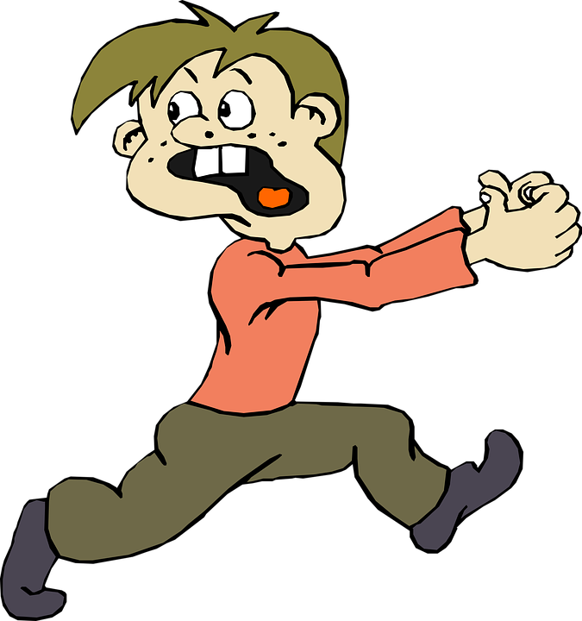
Training intensity
F
1x/wk
7x/wk
I
I
40%MHR
70%MHR
I
2 min
20 min
T
I
Type:
Notes:
Reflection questions: what is the relationship between time and intensity? Is there justification for two choices under “type”?

Slide 12
Patient education: 1. Whiteboard splash, 2. check against this slide,
3. sort into appropriate column (drag & drop)
GENERAL ADVICE
SELF-MONITORING
“STOP IF...”:
Exercise only when someone is around
Excessive SOB
GRADUAL increases in intensity/time
BORG
Pace yourself
Assistive device?
Chest pain
Avoiding quick position changes
Importance of warm up & cool down
Dizziness
Benefits of exercise for her condition
Talk test
What to do if SOB
Notes:
Discussion of optimal vs non-optimal baseline function: How were they before, and were they managing okay? Why did they land in the ER/hospital/etc?
How is/can assistive device be relevant for this patient (she has good balance, what use is a walker? What kind does she need? What are conditions that will affect her ability to do so? Psychosocial factors around A.D. use in such a client?
Discuss reasoning behind importance of each element with contextual examples

Slide 13
Compose one endurance-related SMART goal
S
Specific - MOST common things to measure in CR?
M
Measurable - consider time vs distance
A
Attainable - is setting “without rests” goals appropriate IN THIS CLIENT/population? Why?
R
Relevant - to whom!?
T
Context dependent. Is your goal a STG or LTG? Which is more relevant in the context?
Notes:
Discussion questions:
Quantifiable goals may just be random numbers if they are not meaningful for the client...so how do we know what is meaningful?
Is setting “without rests” goals appropriate? Why or why not?
How can we set goals related to self-management and patient understanding?
I.e. if much of your intervention centres around “patient education”, how would you measure your effectiveness? Be prepared to defend your answers!

Slide 14
Discussion questions:
How can we set goals related to self-management and patient understanding?
I.e. if much of your intervention centres around “patient education”, how would you measure your effectiveness?
How different were your colleagues’ answers compared to yours?
How difficult was it to come to a consensus?

