Slide 1
Words and Literary Analysis
Wednesday, week 1

Slide 2
DICTION: THE RAW MATERIAL
AN AUTHOR’S CHOICE OF WORDS TO CREATE A PARTICULAR EFFECT

Slide 3
WHAT DO AUTHORS DO WITH DICTION?
Play with intensity (from euphemistic to hyperbolic)
Play with level of language (slang, everyday speech, refined, bilingual, archaic, etc.)
PLAY WITH SOUND (HARSH CONSONANTS, MELLOW VOWELS, ETC.)
Play with etymology (choose Germanic vs latin roots)
PLAY WITH CONNOTATIONS

Slide 4
DENOTATION VS CONNOTATION
DENOTATION (noun)/DENOTATIVE (adj): the literal, dictionary sense of the word
Red: a. The hue of the long-wave end of the visible spectrum, evoked in the human observer by radiant energy with wavelengths of approximately 630 to 750 nanometers; any of a group of colors that may vary in lightness and saturation and whose hue resembles that of blood; one of the additive or light primaries; one of the psychological primary hues.
CONNOTATION (noun)/CONNOTATIVE (adj): the associative or emotional meaning of the word

Slide 5
POSITIVE AND NEGATIVE CONNOTATIONS
Bossy
Confident
Decisive
Leader
Authoritarian
Controlling
Etc.

Slide 6
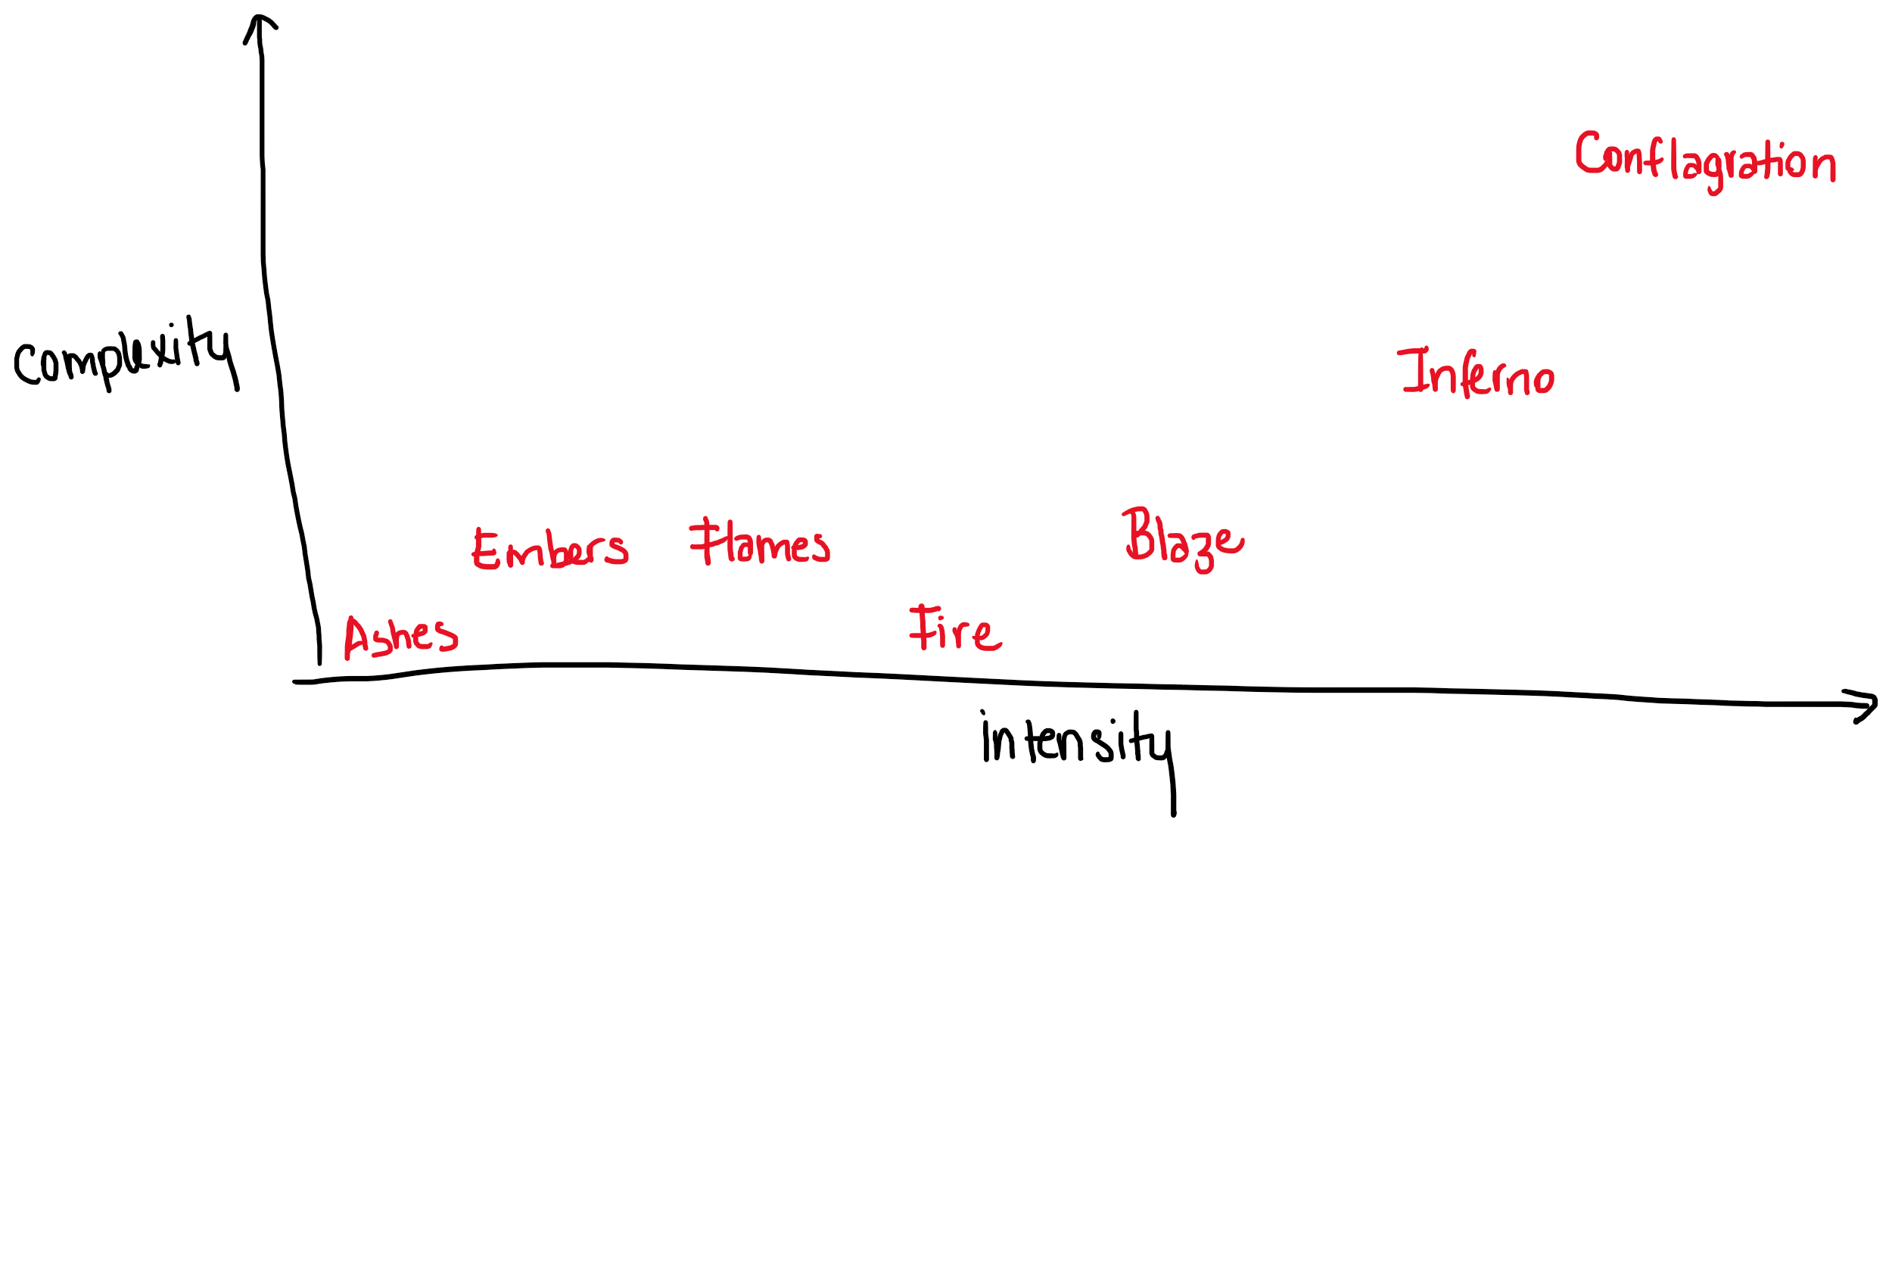
TASKMASTER 1
Find the most intense and complex word for ANGER.
01
You have two minutes.
02
Most complex and intense word wins!
03

Slide 7
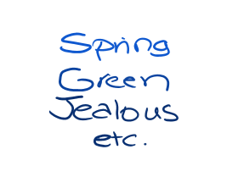
TASKMASTER 2
Make the longest and most accurate chain of synonyms or connotations without repeating the same concept, starting with the word ANIMAL.
You have five minutes.
Longest and most accurate chain wins!

Slide 8
My chain
Animal
Masculine
Strong
Unemotional
Cold
Dead
Direct
Bald
Old
Wise
Clever
Cunning
Foxy
Sexy
Mature
Ripe
Stinky
Corrupt
Bribed
Tempted
Sinful
Pleasurable

Slide 9
Consolidation
In your own words, how do you define…
1. Denotation?
2. Connotation?
Name three aspects of diction you might consider when analyzing an author’s choice of words. In other words, when authors want to create an effect, what aspects of the word would they rely on?

