Slide 1
Basic
Hematology
Erythrocytes
Anemia Part One
Anemia Part Two
Bleeding
Disorders
100
100
100
100
100
200
200
200
200
200
300
300
300
300
300
400
400
400
400
400
500
500
500
500
500

Slide 2
List one PROTECTION function of the blood
30

Slide 3
1. Protects against fluid loss 2. Protects against toxins and pathogens 3. Protects body temperature

Slide 4
Choose the FALSE statement:
60
Typical blood temperature is 37^{O}C.
Homeostatic pH level of blood is around 7.40
On average, males have a larger volume of blood than females.
Plasma volume will be impacted with any changes in the amount of albumin in the blood.

Slide 5
Typical blood temperature is 37^{O}C.

Slide 6
In blood test results, the hematocrit reading indicates the % of _______________ in the blood.
20

Slide 7
Red blood cells

Slide 8
List the blood cells produced in the bone marrow.
45

Slide 9
Erythrocytes
Leukocytes
Thrombocytes

Slide 10
Choose the FALSE statement about leukocytes:
60
They are white blood cells.
They respond to chemical signaling.
They function in specific immune system defense through the creation of antibodies.
They rarely enter tissues.
They function in immune system surveillance.

Slide 11
They rarely enter tissues.

Slide 12
Name the hormone that stimulates hematopoesis and the organ that secretes it
20

Slide 13
Erythropoietin (EPO) from the kidney

Slide 14
What is the primary function of hemoglobin?
30

Slide 15
Transport oxygen

Slide 16
Choose the FALSE statement:
Oxygen binds to the heme groups
Iron is required to form the heme groups
There are 2 globin chains and 4 heme groups in hemoglobin
Carbon dioxide binds to the globin chains
Hemoglobin changes shape as oxygen binds and dissociates
60

Slide 17
There are 2 globin chains and 4 heme groups in hemoglobin

Slide 18
Define secondary polycythemia:
60

Slide 19
An increase in RBC number to compensate for increased oxygen demands in a patient. Examples: living at altitude, COPD, CHF

Slide 20
Choose the FALSE statement:
Red blood cells have a limited lifespan; 90 to 120 days
As hemoglobin is catabolized, amino acids and iron are recycled while bilirubin is excreted in bile.
All blood cells are made in the bone marrow through the process of hematopoiesis.
Red blood cells are exposed to high amounts of mechanical stress; they are continually transcribing and translating proteins to repair the damage.
60

Slide 21
Red blood cells are exposed to high amounts of mechanical stress; they are continually transcribing and translating proteins to repair the damage.

Slide 22
Define anemia.
60

Slide 23
Reduction in oxygen transport, reducing the ability of the patient to carry out normal metabolic function.

Slide 24
List one possible etiology for hemolytic anemia
45

Slide 25
Sickle cell anemia Transfusion reaction Immune reaction Some toxins Malaria

Slide 26
Explain why tachycardia is a clinical manifestation of anemia.
60

Slide 27
Cardiovascular compensation for reduced oxygen delivery

Slide 28
EXPLAIN one complication of sickle cell anemia:
60

Slide 29
Micro-clotting Growth restriction Exercise intolerance Immune system suppression

Slide 30
CHOOSE ALL THAT APPLY: A patient with hemolytic anemia is likely to also present with which of the following:
Jaundice
Hemoglobinuria
Hematuria
45

Slide 31
a) Jaundice b) Hemoglobinuria

Slide 32
A lack of vitamin B12 can cause anemia. WHY?
60

Slide 33
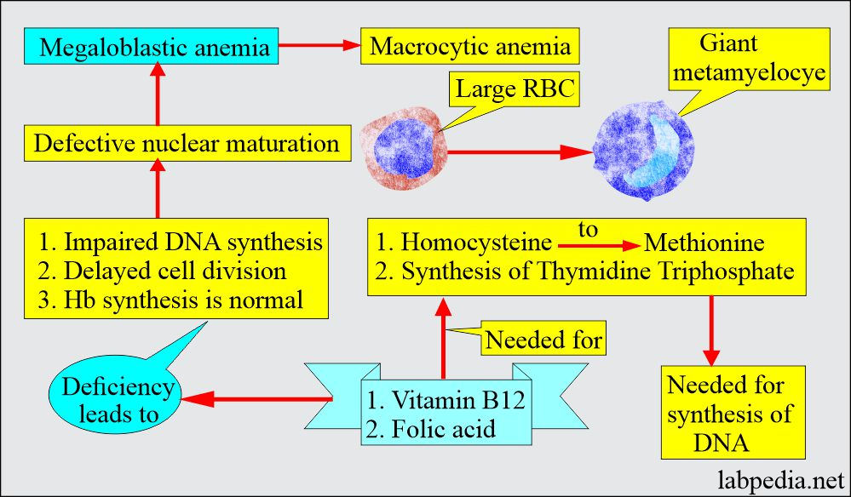
Vitamin B12 is a cofactor needed for efficient DNA synthesis of RBCs in the bone marrow.

Slide 34
List the two main etiologies for iron-deficiency anemia.
45

Slide 35
1. Dietary lack of iron intake/absorption 2.Chronic loss of RBCs

Slide 36
Explain why women are more at risk of iron-deficiency anemia than men.
30

Slide 37
Monthly menstrual flow (and pregnancy)

Slide 38
True or False: Anemia can cause angina.
30

Slide 39
True – temporary lack of oxygen during a stressful situation (physical or relative stress)

Slide 40
Choose the FALSE statement:
A sickling crisis is defined as an increased rate of RBC deoxygenation, with several possible etiologies.
Sickled RBCs have a lifespan of only 20 days, effectively reducing the number of circulating erythrocytes.
Damage to the RBCs is repaired through increased transcription and translation of cell membrane proteins, which requires extra folate.
Genetically inherited abnormal hemoglobin (HbS) crystallizes when it is deoxygenated.
60

Slide 41
Damage to the RBCs is repaired through increased transcription and translation of cell membrane proteins, which requires extra folate.

Slide 42
List the most important factor in the management of hemophilia.
30

Slide 43
PREVENTION: lifestyle changes safety measures awareness

Slide 44
Which statement about platelet function is FALSE?
Platelets function to release chemicals to initiate the clotting cascade.
Platelets help to form a temporary patch in the wall of a damaged blood vessel.
Actin and myosin within a platelet will contract after the clot forms, helping to pull the damaged tissue together.
Extra platelets are stored in the spleen and are released when we have an infection.
60

Slide 45
Extra platelets are stored in the spleen and are released when we have an infection.

Slide 46
Define the condition of disseminated intravascular coagulation (DIC)
60

Slide 47
Increased coagulation that leads to widespread bleeding as coagulation factors have been exhausted

Slide 48
List three clinical manifestations of DIC:
45

Slide 49
Petechiae Bleeding (internal and external) Hemolytic anemia Microthrombi Compensatory mechanisms (cardiovascular and respiratory)

Slide 50
Choose the FALSE statement:
a)Hemophilia A is the most common form of hemophilia.
b) Men are hemophiliac more often than women and men pass the hemophilia along to their sons.
c) Medical interventions include providing patients with Factor VIII to help stimulate clotting.
d) Patients are at increased risk of anemia and hypovolemic shock.
60

Slide 51
Men are hemophiliac more often than women and men pass the hemophilia along to their sons.

